Slide 1
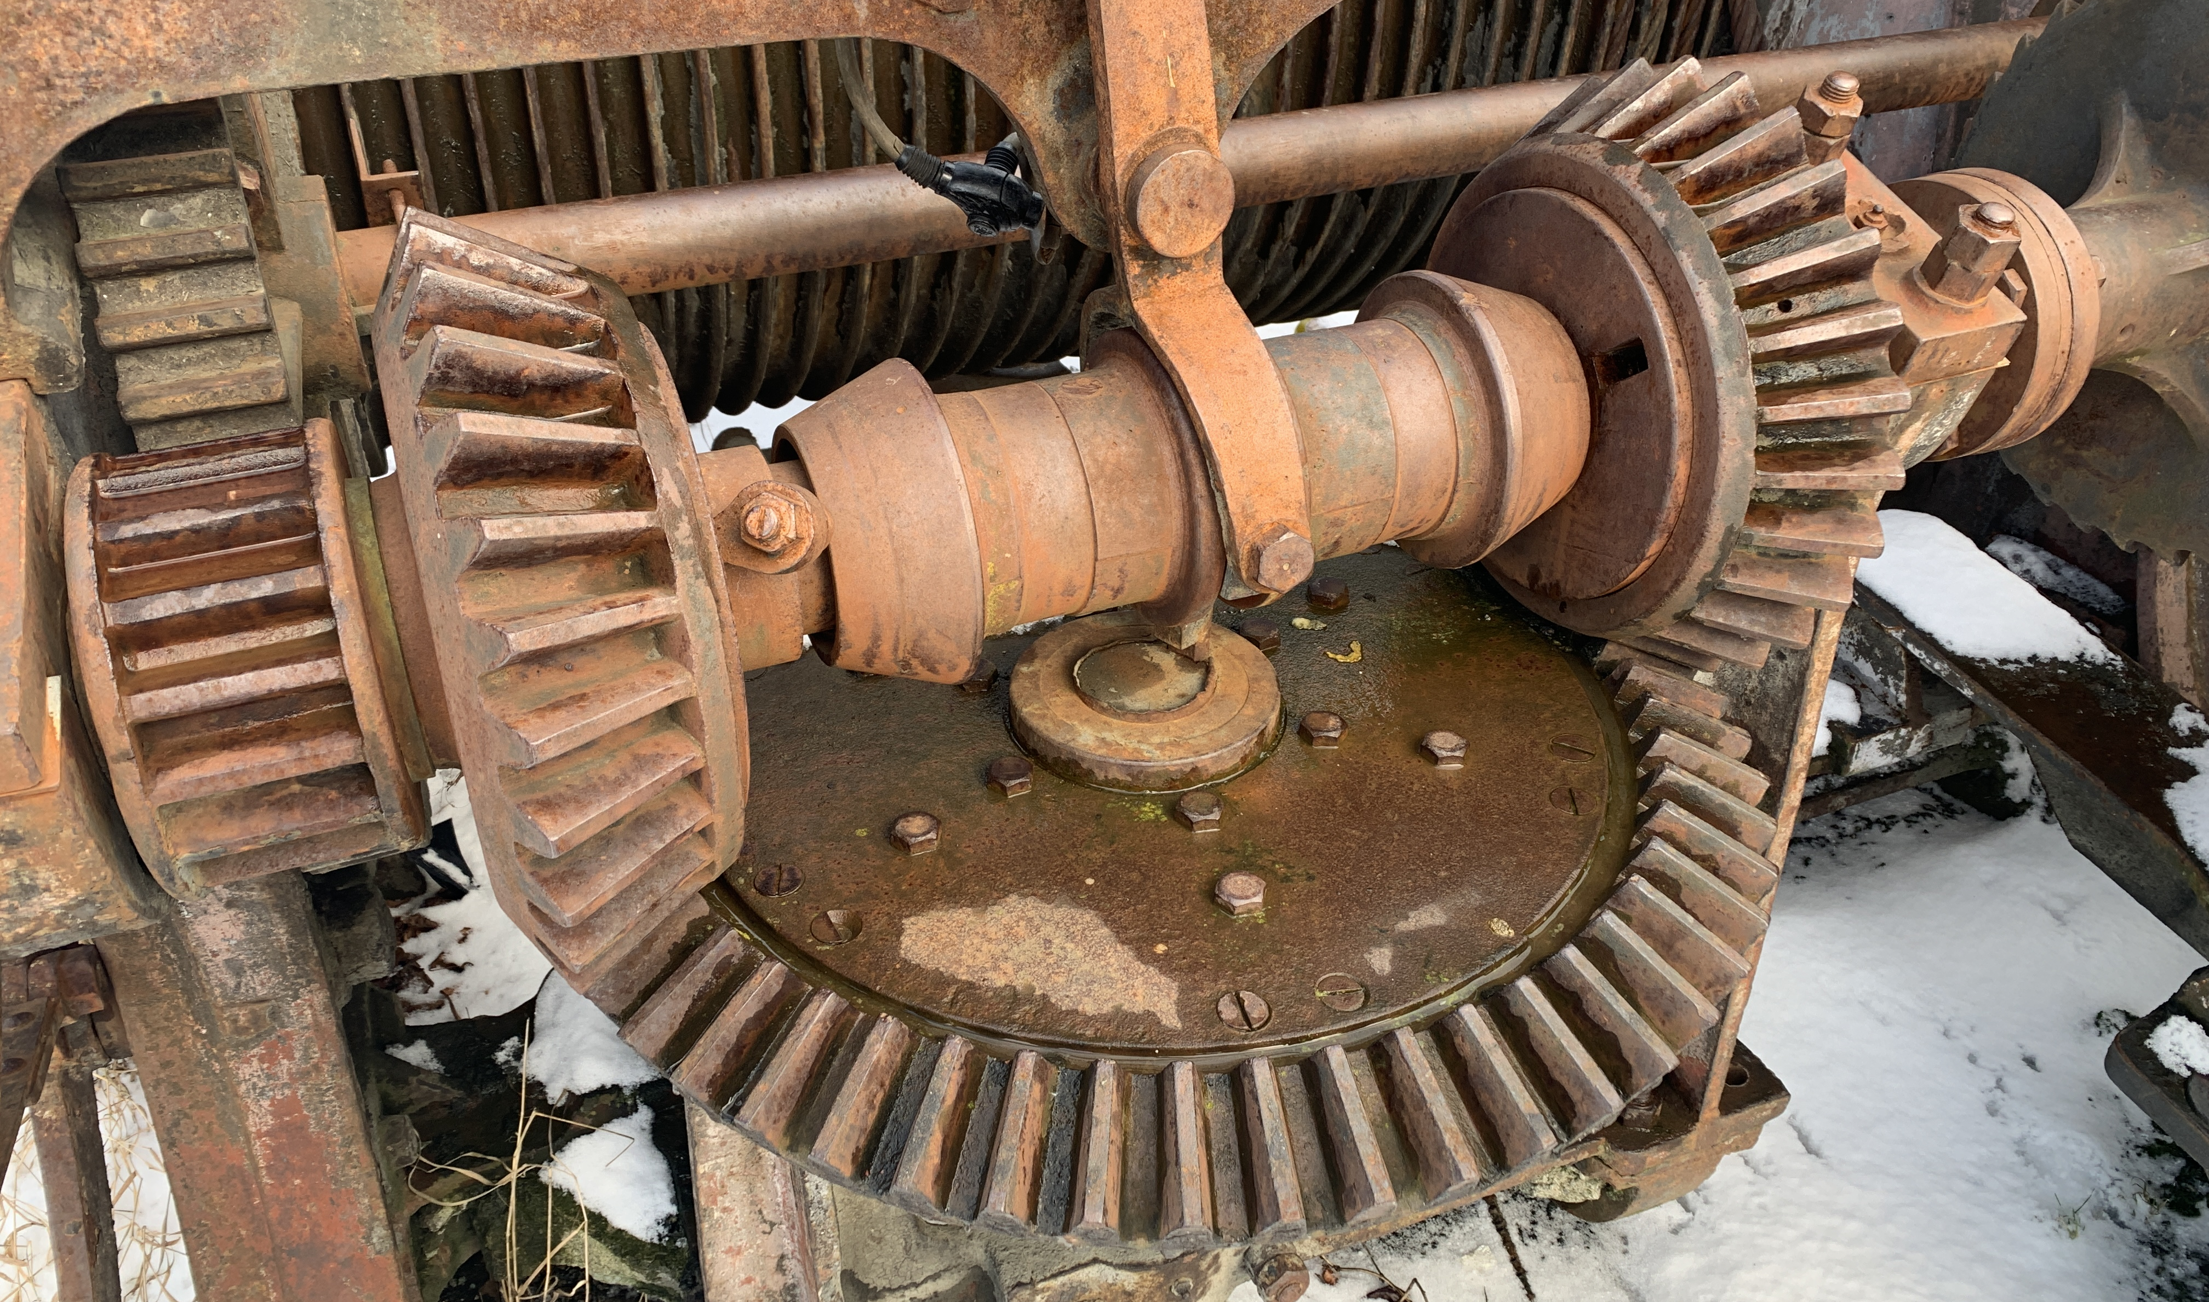
Can gears that engage only so good make the machine run?
Øyvind Teig, Trondheim, Norway
Fringe presentation at COPA 2025 April 21-24 (https://ieee-copa.org/)
27Mar2025
1/26

Slide 2
This conference «fringe» presentation explains an implementation which reads from a MEMS microphone and writes to a headset DAC
To avoid using an external PLL chip, clock output pulses rather unusually vary some in time
The timing of these «staccato» pulses is taken from a software table with 10 ns tick resolution (100 MHz)
The pattern thus generated repeats exactly every 62.5 µs, giving a stereo frame rate of 16,000 Hz
The table contains 128 elements; two edges per pulse * 32 bits * two channels, each representing the number of ticks to the next clock signal edge output
The presentation shows that this controlled unevenness correctly picks up the data bits from the microphone chip or delivers the data bits to the headset chip
A processor from XMOS (UK) is used for this
Abstract

Slide 3
Are the ? ? ? ok?
16.0 kHz = 62.5 μs = 6250 ticks
????????????????????????????????
Mic-in & headset-out (monitor) clock edges @2.048 MHz max
Precise average per 16 kHz frame
But table driven skewed timing of «staccato» clock pulses ? ? ?
Coded in (somewhat) obsoleted XC
New paradigm from XMOS is C plus lib_xcore

Slide 4
Application listens for recorded «alarm» sounds
Alarms hearing deficient people
Fully implemented since I retired
Industrialisation of the product not yet conceived
Could Apple iOS AI-based «Sound recognition» possibly do the same?
Application
TDM
BUF
PCM
«Beep-BRRR»
hobby project
DSP
https://www.teigfam.net/oyvind/home/my-beep-brrr-pages/

Slide 5
Problem statement
16.0 kHz = 62.5 μs = 6250 ticks of 10 ns @ 100 MHz task timer resolution
????????????????????????????????
16 kHz stereo @ 32 bits each = 64 bits = 128 edges
Processor task timer @100 MHz
128 edges * 16000 = 2.048 MHz
1 / 16000 Hz = 0.000062500 s = 62.5 μs = 6250 ticks of 10 ns
Integer ticks! GREAT!
Also task timer resolution
6250 ticks to deliver 128 edges =
6250 / 128 = 48.828125 ticks between each edge
Decimal ticks! Needing extern PLL?
5/26

Slide 6
Problem solution?
16.0 kHz = 62.5 μs = 6250 ticks of 10 ns @ 100 MHz task timer resolution
????????????????????????????????
6250 ticks to deliver 128 edges =
6250 / 128 = 48.828125 ticks between each edge
Decimal ticks! Needing extern PLL?
Not if BCK duty cycle requirement is «fair» so that we can tabulate uneven timing, and sum up 128 uneven edges to exactly 6250 ticks

Slide 7
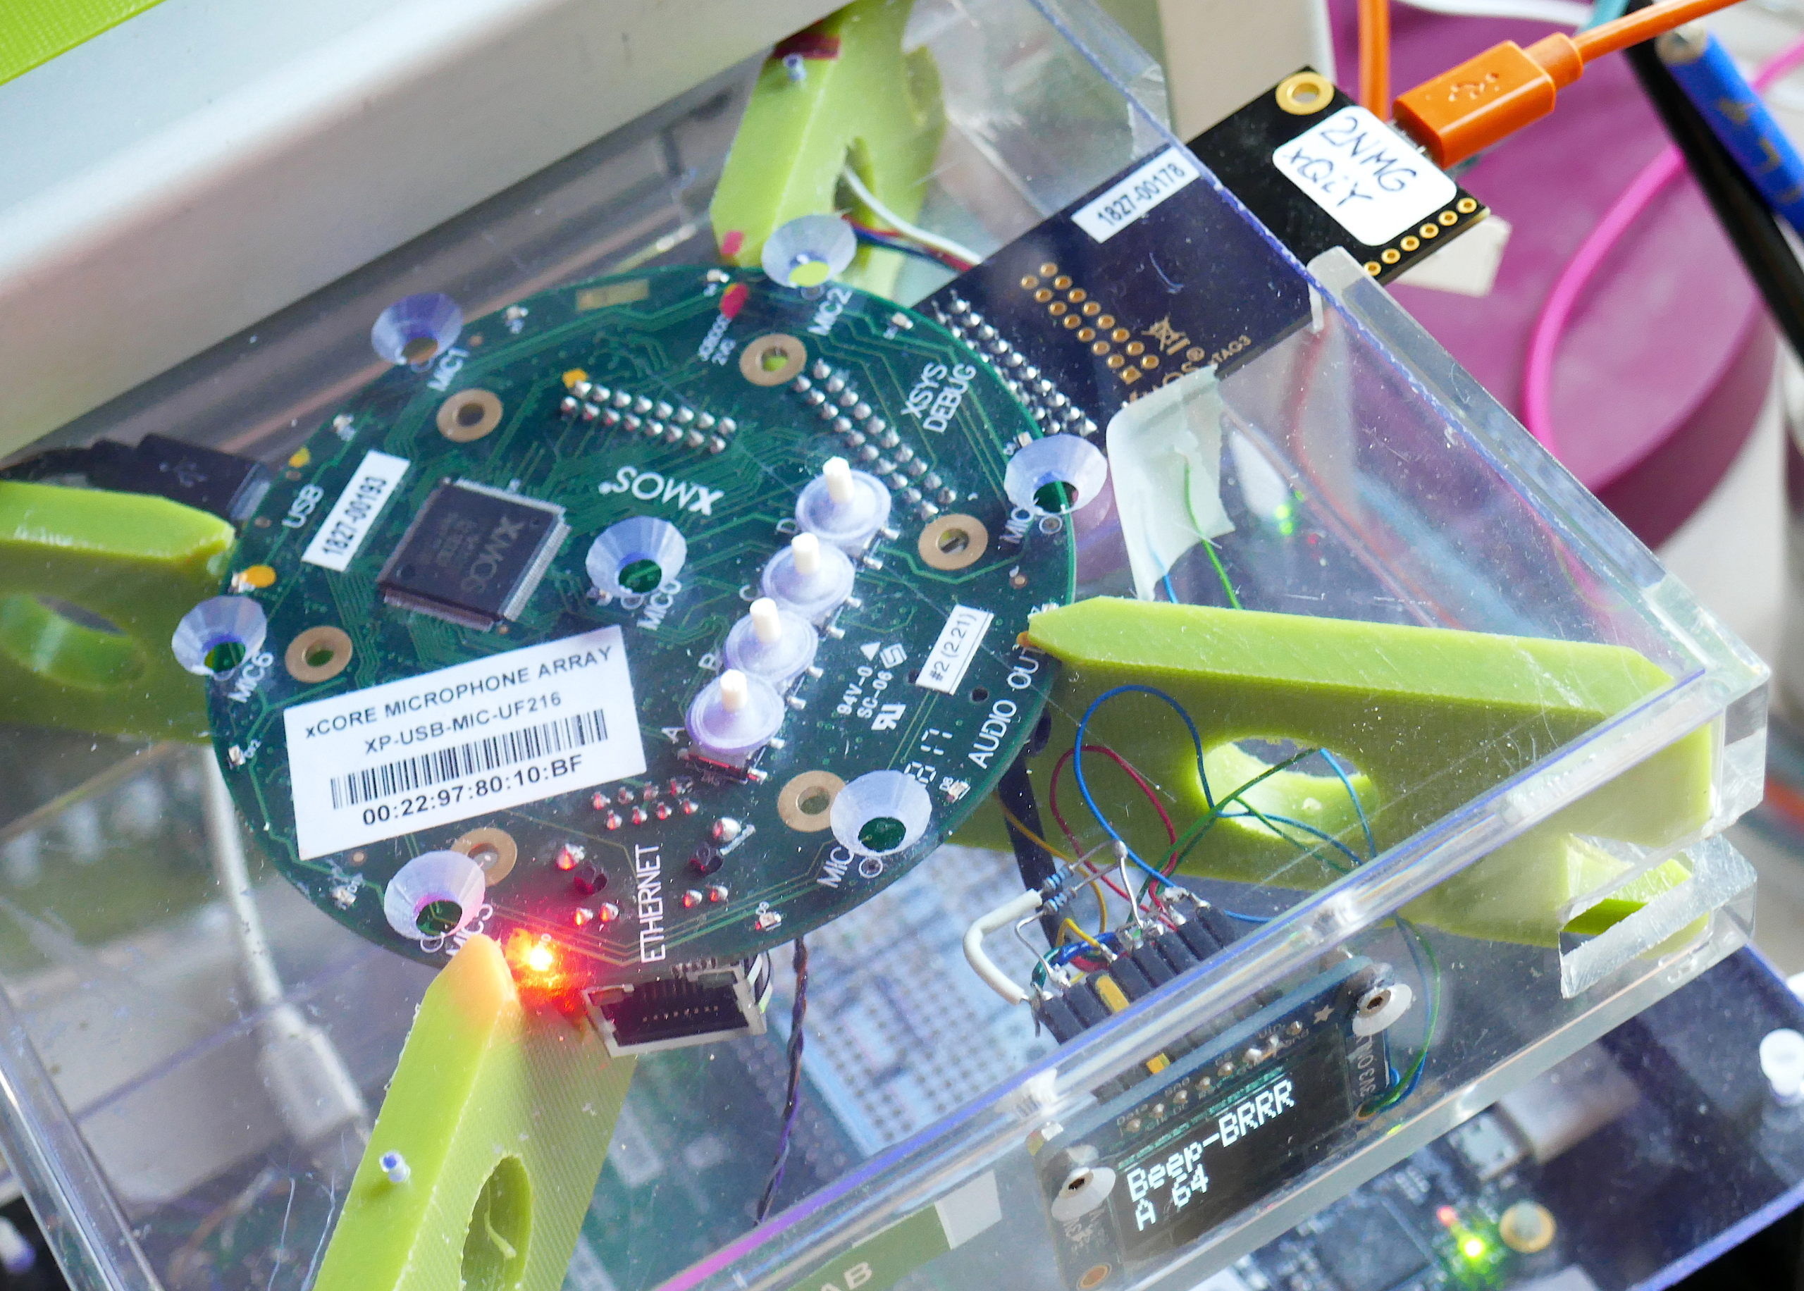
Mark 1: using audio-ready board
XMOS xCore Microphone array evaluation board
On-board microphones
On-board headset amplifier
On-board PLL clock
XMOS libraries
Obsoleted, but used in my BEEP-BRRR mark 1 (one built)

Slide 8
Mark 1: using audio-ready board
(Excerpt)
Seven INFINEON IM69D130 MEMS microphones
This board is obsoleted for other microphone boards
16 32-bit logical processing cores that deliver up to 2000 MIPS
Headset
..and I broke my board #2
The CS2100 generates a low-jitter output signal that is distributed to the xCORE- 200 device (Tile1 & MCLK) and DAC (MIC-CLK). The CS2100 device is configured using the I2C interface
Low jitter clock source - 24.576MHz oscillator, used as reference clock to the CS2100-CP (CirrusLogic) Fractional-N PLL

Slide 9
Mark 1: using audio-ready board
Mark 2 (next page)
Find a more general board and not need to use these
XMOS libraries
The xCORE-200 explorer board
USED_MODULES += lib_mic_array
Configure the PLL for the specified board
The i2c bus used to configure the audio codec
Try no external PLL
Updated 4.24
USED_MODULES += lib_mic_array_board_support
PDM interface
Four channel decimators
High resolution delay block (since 7 mics)
Try to «bit bang» this myself..
Try to find a mic that contains decimation SW
..from basically 100 MHz XC task timer tick resolution (10 ns)
I only need one mic

Slide 10
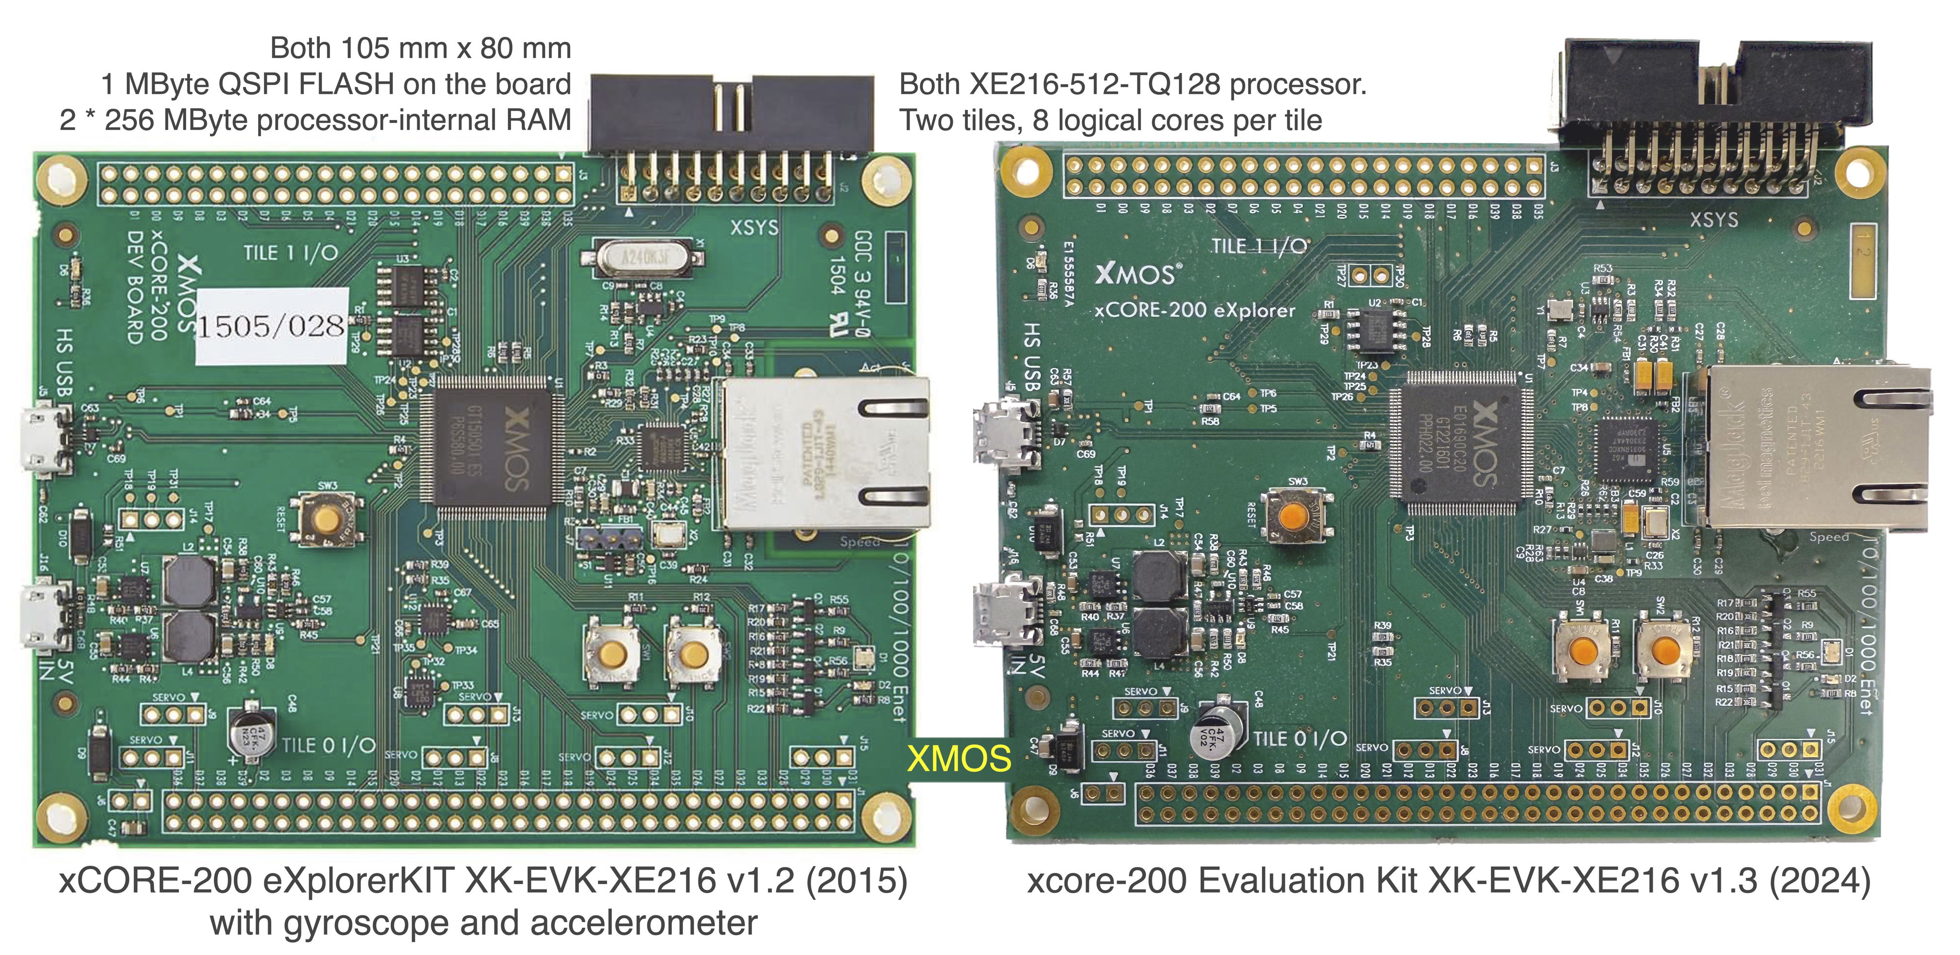
Mark 2: using a general board
XMOS xCore-200 explorer evaluation board
External microphone
External headset amplifier
2015
(Mine)
2024
Try NOT to use any external PLL (there is no on-board PLL)
Using this in my BEEP-BRRR mark 2 (two built)
10/26

Slide 11
External microphone
Mark 2: using a general board
EV_ICS-52000-FX AN-000001 single MEMS microphone from TDK InvenSense (evaluation board)
Clocked as TDM by 1024 kHz pulses it delivers 16 kHz mono (+ ghost channel)
Fully processed as decimated signed 2’s complement values
Obsoleted 🧐

Slide 12
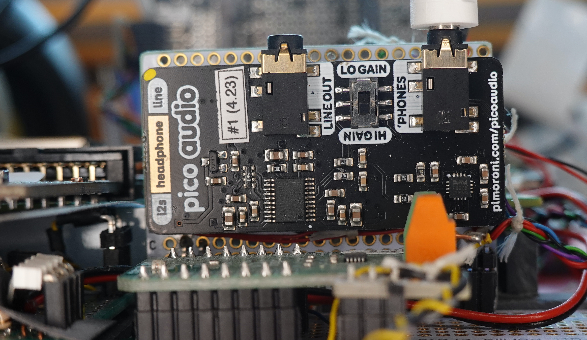
Mark 2: using a general board
External headset amp (monitor)
Pimoroni Pico Audio Pack (Line-Out and Headphone Amp) PIM544
Contains a Texas Instruments PCM5100 DAC ← signed 32 bits
2’s complement @1024 kHz for 16 kHz stereo into the headset
I2S and left-justified input data formats
Integrated PLL for no external system master clock input
Internal filters

Slide 13
Microphone

Slide 14
Microphone
SCK (INPUT): Serial Data Clock for TDM Interface
SD (OUTPUT): Serial Data Output for TDM Interface
WS (INPUT): Serial Data-Word Select for TDM Interface
WSO (OUTPUT): Word Select Output, daisy-chain

Slide 15
Microphone
✅
15/26

Slide 16
Microphone
( )
✅

Slide 17
Headset
Duty cycle requirement hard to find

Slide 18
Headset
✅

Slide 19
XC is C syntax + X
#define CLK_MAX_32_MONOTENOUS_HIGH_TICKS \
{/* COL1 COL2 */\
TIME_50_TICKS, \
TIME_50_TICKS - TIME_01_TICK, \
TIME_50_TICKS, \
TIME_50_TICKS, \
TIME_50_TICKS - TIME_01_TICK, \
TIME_50_TICKS, \
TIME_50_TICKS, \
TIME_50_TICKS - TIME_01_TICK, \
TIME_50_TICKS, \
TIME_50_TICKS, \
TIME_50_TICKS - TIME_01_TICK, \
TIME_50_TICKS, \
TIME_50_TICKS, \
TIME_50_TICKS - TIME_01_TICK, \
TIME_50_TICKS, \
TIME_50_TICKS, \
TIME_50_TICKS - TIME_01_TICK, \
TIME_50_TICKS, \
TIME_50_TICKS, \
TIME_50_TICKS - TIME_01_TICK, \
TIME_50_TICKS, \
TIME_50_TICKS, \
TIME_50_TICKS - TIME_01_TICK, \
TIME_50_TICKS, \
TIME_50_TICKS, \
TIME_50_TICKS - TIME_01_TICK, \
TIME_50_TICKS, \
TIME_50_TICKS, \
TIME_50_TICKS - TIME_01_TICK, \
TIME_50_TICKS, \
TIME_50_TICKS, \
TIME_50_TICKS - TIME_01_TICK, \
}
1 tick = 10 ns
#define CLK_MAX_32_MONOTENOUS_LOW_TICKS \
{/* COL3 COL4 */\
TIME_47_TICKS + TIME_01_TICK, \
TIME_47_TICKS + TIME_01_TICK, \
TIME_47_TICKS + TIME_01_TICK, \
TIME_47_TICKS + TIME_01_TICK, \
TIME_47_TICKS + TIME_01_TICK, \
TIME_47_TICKS + TIME_01_TICK, \
TIME_47_TICKS + TIME_01_TICK, \
TIME_47_TICKS + TIME_01_TICK, \
TIME_47_TICKS + TIME_01_TICK, \
TIME_47_TICKS + TIME_01_TICK, \
TIME_47_TICKS + TIME_01_TICK, \
TIME_47_TICKS + TIME_01_TICK, \
TIME_47_TICKS + TIME_01_TICK, \
TIME_47_TICKS + TIME_01_TICK, \
TIME_47_TICKS + TIME_01_TICK, \
TIME_47_TICKS + TIME_01_TICK, \
TIME_47_TICKS + TIME_01_TICK, \
TIME_47_TICKS + TIME_01_TICK, \
TIME_47_TICKS + TIME_01_TICK, \
TIME_47_TICKS + TIME_01_TICK, \
TIME_47_TICKS + TIME_01_TICK, \
TIME_47_TICKS + TIME_01_TICK, \
TIME_47_TICKS + TIME_01_TICK, \
TIME_47_TICKS + TIME_01_TICK, \
TIME_47_TICKS + TIME_01_TICK, \
TIME_47_TICKS + TIME_01_TICK, \
TIME_47_TICKS + TIME_01_TICK, \
TIME_47_TICKS + TIME_01_TICK, \
TIME_47_TICKS + TIME_01_TICK, \
TIME_47_TICKS + TIME_01_TICK, \
TIME_47_TICKS + TIME_01_TICK, \
TIME_47_TICKS + TIME_01_TICK, \
}
(50 * 21) +
(49 * 11) =
1589 ticks
(48 * 32) =
1536 ticks
1589 + 1536 =
3125 ticks
3125 * 2 =
6250 ticks * 10 ns =
62.5 μs =
stereo @ 16 kHz
This works for both
mic ICS-52000 and
headset PCM5100
✅

Slide 20
20/26

Slide 21
Microphone
mic_ics52000_stereo_in_16kHz_task_m
void mic_ics52000_stereo_in_16kHz_task_m ( // ICS-52000. USING THIS
out port po_WS_mic,
in port pi_SD_mic,
out port po_SCK_mic,
streaming chanend sch_ma, // 16 kHz knock!
chanend ch_ama) // 16 kHz come! data! = bidirectional
{
SCK_ticks_t timeout_next_edge_ticks_128arr [NUM_EDGES_STEREO_128];
unsigned ibits_stereo_decs_128arr [NUM_EDGES_STEREO_128];
unsigned imic_128arr [NUM_EDGES_STEREO_128];
port_val_e port_WS_128arr [NUM_EDGES_STEREO_128];
audio_sampling_state_e audio_sampling_state_128arr [NUM_EDGES_STEREO_128];
audio_t SD_in_bit0;
make_2048kHz_edges_for_16kHz_stereo_ticks (
timeout_next_edge_ticks_128arr); // 128: SCK_ticks_t audio, 6250 ticks (62.5 us)
make_ics52000_stereo_bitbanged_params (
ibits_stereo_decs_128arr, // 128: [31,31.. 0,0][31,31.. 0,0]
imic_128arr, // 128: [0.. 1] 64 of each
port_WS_128arr, // 128: [PORT_HIGH,PORT_HIGH, then 126 PORT_LOW]
audio_sampling_state_128arr); // 128: audio_sampling_state_e as pairs of 64
// More init
// while (true) // next page
} // mic_ics52000_stereo_in_16kHz_task_m
«All» is table driven to avoid unnecessary if-tests
{
XC code compiled with XMOS xTIMEcomposer 14.4.1 (Dec2019). Now C + lib_xcore new choice for new products

Slide 22
mic_ics52000_stereo_in_16kHz_task_m (cont.)
while (true) {
[[ordered]]
select {
case ch_ama :> knock_come_frame_number_expected : {
audio_send_actions = asa_got_come_send;
} break;
case tmr_SCK when timerafter (tmr_SCK_timeout_ticks) :> void: {
const audio_sampling_state_e audio_sampling_state = audio_sampling_state_128arr [iedge_incs];
// Do all port outputs immediately to get the least SCK duty cycle variations:
po_WS_mic <: po_WS_val; // BIT0
po_SCK_mic <: po_SCK_bit0_val; // BIT0
if (audio_sampling_state == ass_in_bit) {
pi_SD_mic :> SD_in_bit0;
} else {}
switch (audio_send_actions) { // HANDLE SEND STATE MACHINE
// State and table driven code
}
switch (audio_sampling_state) { // HANDLE ICS-52000 STATES
// State and table driven code
}
po_SCK_bit0_val = iedge_incs;
iedge_incs = (iedge_incs + 1) % NUM_EDGES_STEREO_128;
po_WS_val = port_WS_128arr[iedge_incs]; // For next port output
tmr_SCK_timeout_ticks += timeout_next_edge_ticks_128arr [iedge_incs];
} break;
} // select
} // while
✅

Slide 23
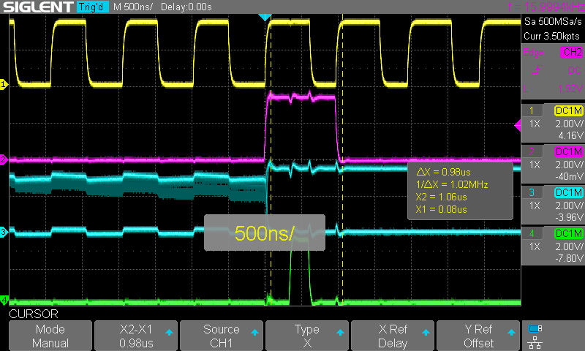
Microphone
500
ns
≈B
≈C
≈D
≈E
SCK
WS
SD
RD
«2023 09 26 v09373 FLASHED STEREO with two mics in, but only right used SDS00233.png»
✅

Slide 24
Message sequence diagram (MSG)
Headset out
Mic in
Buffer, router, gain, framer
1: Starting to get rid of mic bits by «KNOCK» when bit23-bit0 have been read @24 bits into each 64 bits frame (mono)
3:
2:
«2025 03 12 Beep-BRRR Message Sequence Chart MSC.pages /PDF»
✅
24/26

Slide 25
Why this works
Tolerant mic input and headset output chips!
Pins (I/O) are treated directly in XC, talking with I/O HW units
No interrupt handlers of any sort, ie. no priority or any nested such
XMOS xCore «logical core» tasks do not interfere with each other. 8 cores per tile. Two tiles
(HW scheduler and round robin cycles sharing. Broadly speaking 1/8 of cycles per core per tile)
The three tasks shown here run on tile[0] and a core[n] each
My 10 ns timer ticks resolution is only up to «this» task,..
provided communication is instant (here using chan and streaming chan)
For the mic this means the code will have to do the next edge within some 470 ns sharp
Using my «knock-come» deadlock free pattern then «disturbance» from communication is well within this
✅
25/26

Slide 26
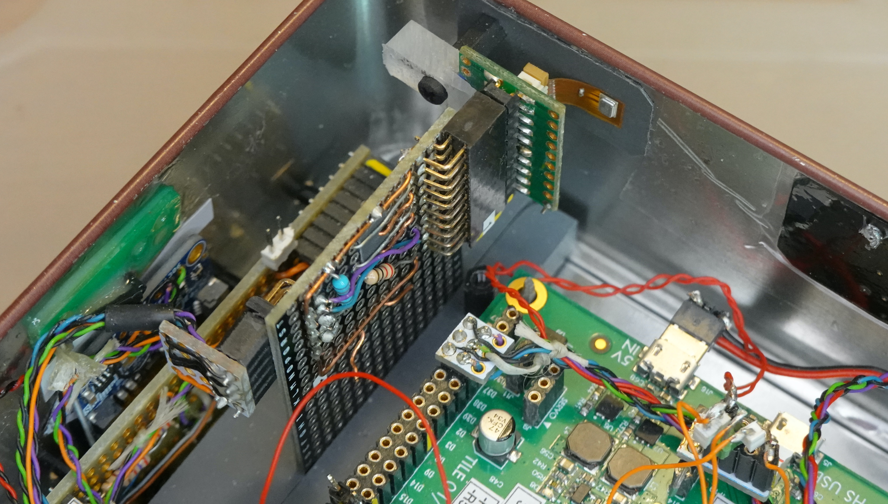
Thank you!
✅
Øyvind Teig, Trondheim, Norway
This presentation also published at https://www.teigfam.net/oyvind/home/technology/266-ieee-copa-2025-fringe/
26/26

