Slide 1
Hooping with xC
Torus heat equations
to get dizzy from
✅

Slide 2
Øyvind Teig
Fringe presentation at IEEE-COPA 2021
ieee-copa.org
Dr. Lawrence John Dickson
Last edits: Øyvind: 24. April 2021 at 17.17 Norway time ✅ - Larry: 18. April 2021 at 14:23 California time ☑️

Slide 3
Øyvind Teig
40(+) years with safety critical systems at
Autronica Fire and Security AS. HW + SW
Was Senior development engineer with
Master’s degree («Siv.ing») from NTH (now NTNU) in 1975
Retired since June 2017
Now blogging: www.teigfam.net/oyvind/home/
Disclaimer: no money, no gifts, no ads - only fun and expenses
I have no association with XMOS
But I am using xC and XMOS boards in several projects
Now also NTNU affiliated: www.ntnu.edu/employees/oyvind.teig
I live in Trondheim, Norway
✅

Slide 4
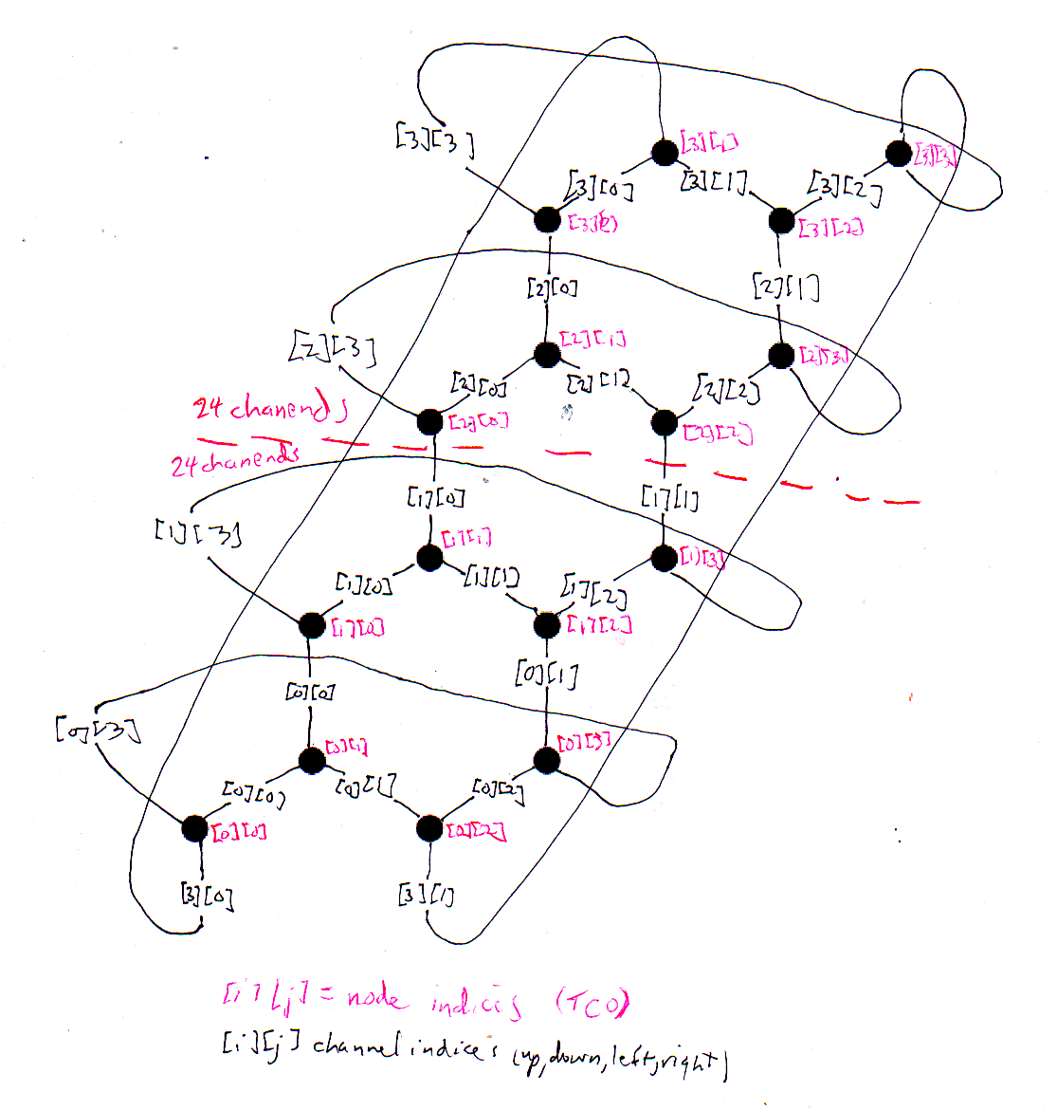
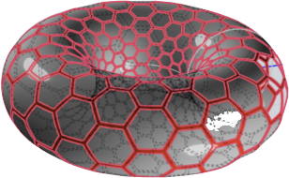
Dr. Lawrence John Dickson
Chief Scientist, Space Sciences Corporation
After the xC/xCORE had been introduced to Larry,
then these drawings started our joint venture
Plus some code examples coded in occam (for transputers), and tested in occam and C
(Larry and Øyvind met at «CPA conferences»)
✅

Slide 5
Problem description (1)
The story on how points representing temperature on a torus, in the form of these occam PROCs running on one or several transputers,
exchanging temperature with their neighbours,
caught the interest of whether or how this problem may be run as xC tasks on the XMOS xCORE multicore architecture
xC is "C plus multicore extensions" (XMOS)
Drawn as a strict table is not as «torus-intuitive»
✅

Slide 6
Problem description (2)
INMOS, occam, transputer → XMOS, xC, xCORE, both in Bristol, UK
Both do concurrency with built-in schedulers, for those applications (and users) who enjoy living without any operating system layer
However, xC looks more like C, the toolset even compiles C and C++ (built using Clang/LLVM),
plus the xCORE has more concurrency primitives realised as HW units. Now hard deadlines may be guaranteed.
The xC/xCORE probably was not designed for the «torus kind» of problem. But how far can we stretch it?
✅

Slide 7
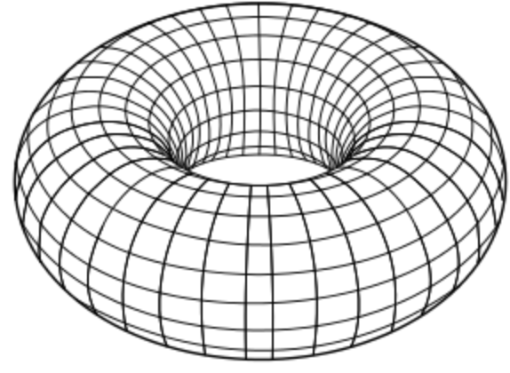
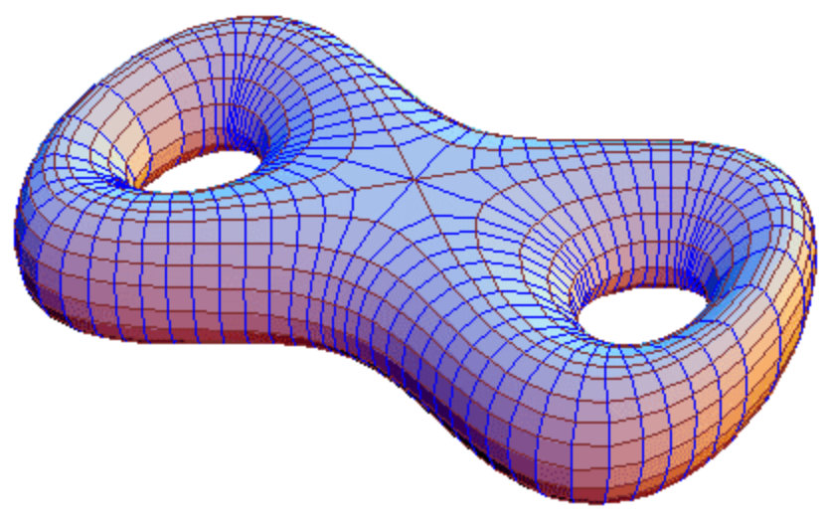
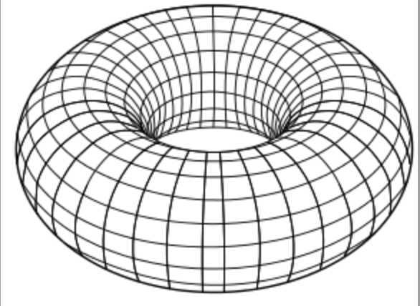
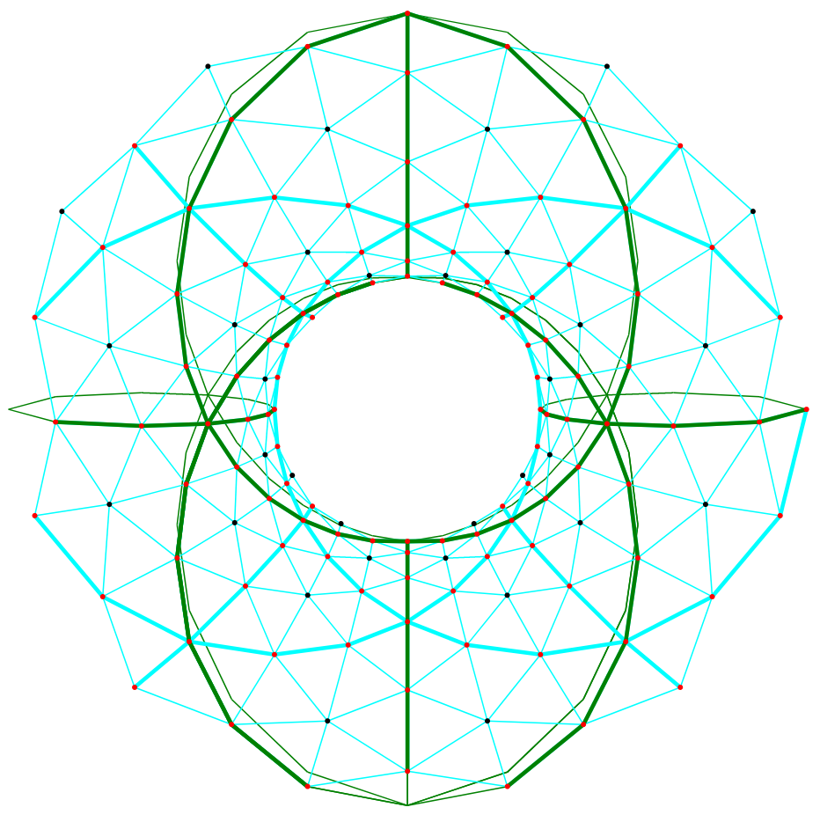
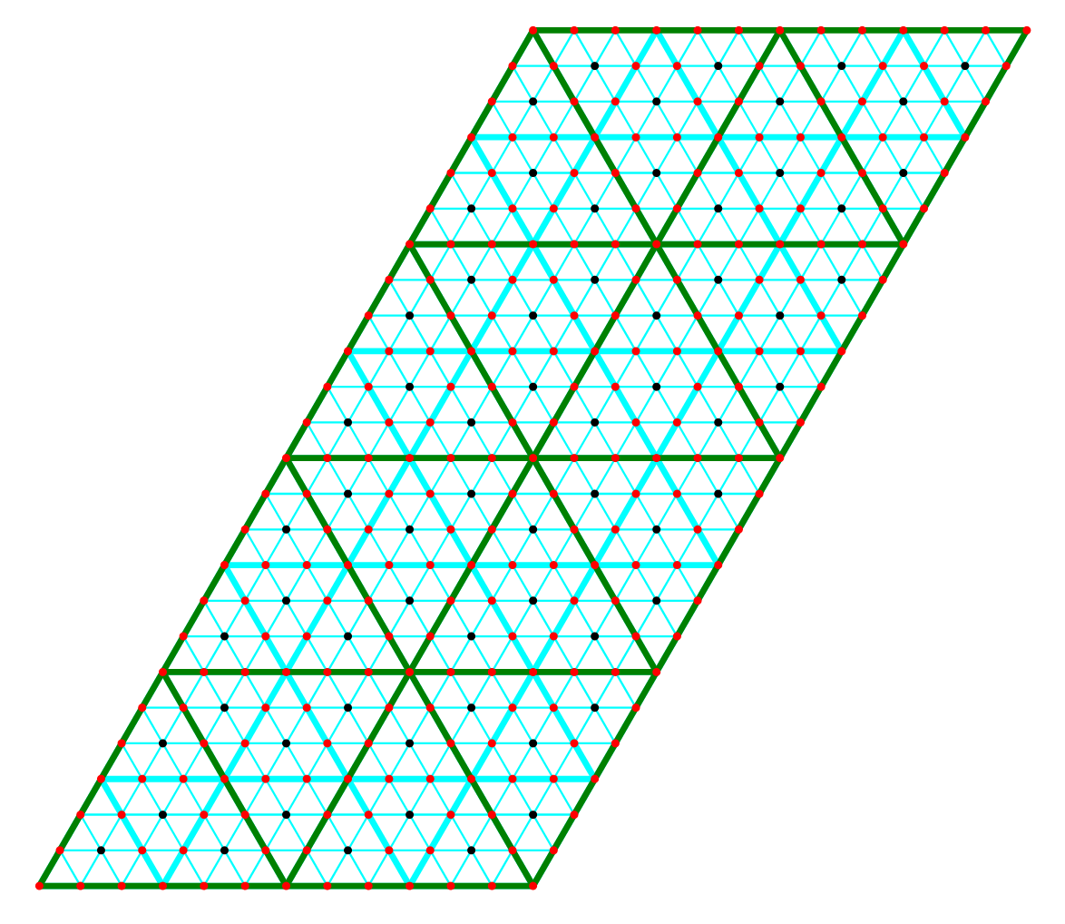
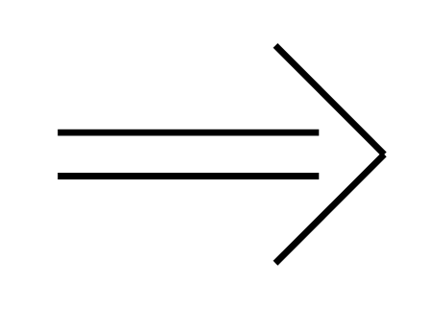
GEOMETRY
Sphere
Torus
Double Torus
Elliptic
Euclidean
Hyperbolic
Green is 4 x 4
Thick cyan is 8 x 8
Thin cyan is 24 x 24
Thin green is behind the Torus
All others are in front
Euclidean has no exceptional vertices
PARALLELOGRAM
TORUS
☑️

Slide 8
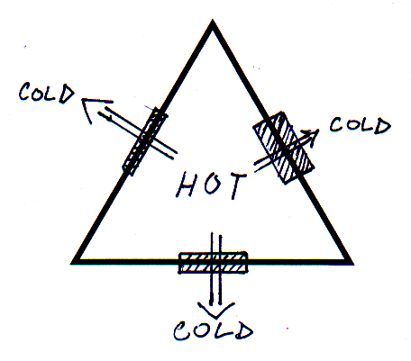
PHYSICS
Linear heat flow
Each node (triangle):
Change in temperature (K) =
Sum{Energy flow(W)}*Time(sec)/
(Heat capacity)
Each connection (edge):
Energy flow(W) =
Temperature difference(K)*
(Heat conductance)
Three physical connections per node
Heat capacities may vary between nodes
Heat conductances may vary between connections
Energy transmission is local
Energy transmission is linear
Energy is conserved in the system
☑️

Slide 9
MATHEMATICS
The parallelogram can be mapped conformally onto the torus.
Left and right edge are identified, and bottom and top edge are identified.
The torus is made by rotating a circle, whose radius is the minor radius r, around an axis that is in the plane of the circle and does not intersect it. The distance from the axis to the center of the circle (called the spine) is the major radius R. Note that R > r.
We may assume the axis is the z-axis and the spine is in the xy-plane. Then the torus can be parametrized by $θ$ and $ϕ$ where $(x,y,z)=((R+rcos(θ))cos(ϕ),(R+rcos(θ))sin(ϕ),rsin(θ))$
where the variables are everywhere orthogonal. Since the arc length derivatives are $\frac{ds}{dθ}=r$ and $\frac{ds}{dϕ}=R+rcos(θ)$, it follows from the chain rule that if $θ=θ(ψ)$ and $r\frac{dθ}{dψ}=R+rcos(θ)$, then the map from $(ψ,ϕ)$ onto the torus is locally conformal and hence conformal.
This differential equation is easily solved for the inverse function $ψ(θ)$: $\frac{dψ}{dθ}=\frac{r}{R+rcos(θ)}$, which by tables of integrals has the
solution $ψ=\frac{2r}{\sqrt{R^{2}-r^{2}}}\tan^{-1}\left(\sqrt{\frac{R-r}{R+r}}tan\frac{θ}{2}\right)$, whence it follows that $θ=2\tan^{-1}\left(\sqrt{\frac{R+r}{R-r}}tan(\frac{\sqrt{R^{2}-r^{2}}}{2r}ψ)\right)=2\tan^{-1}\left(\sqrt{\frac{R+r}{R-r}}tan\frac{χ}{2}\right)$, where $χ=\frac{\sqrt{R^{2}-r^{2}}}{r}ψ$. Here,
$-π≤χ≤π$ and $-π≤ϕ≤π$. So the aspect ratio of the rectangle (or parallelogram) conformally mapped onto the torus is $\frac{r}{\sqrt{R^{2}-r^{2}}}$.
The aspect ratio of parallelogram mapped onto the torus of the Geometry slide is $\frac{1}{\sqrt{3}}$.
This allows the triangles mapped onto the Torus to be equilateral, with same i and j dimensions.
These dimensions have to be even, allowing for Client and Server classification of triangles.
☑️

Slide 10
COMPUTATION (CSP/OCCAM MODEL)
The new temperature calculation implied by the physics is shown in C as
temp_new = temp_old + (tempin[0]-temp_old)*wt[0] +
(tempin[1]-temp_old)*wt[1] +
(tempin[2]-temp_old)*wt[2];
where a constant wt[i] value is preset:
wt[i] = heat_conductance[i]*deltime/heat_capacity;
This is easily modeled in CSP communicating processes, one for each node, if neighbors transmit their old temperatures to each other to supply tempin[i]. Thus, each cycle requires each node to do three outputs and three inputs, followed by the above calculation. In occam, this code snippet is
WHILE notdone
SEQ
PAR
to.left ! temp.old
to.vert ! temp.old
to.right ! temp.old
from.left ? tempin[0]
from.vert ? tempin[1]
from.right ? tempin[2]
temp.new := temp.old +
(( ((tempin[0]-temp.old)*wt[0]) +
((tempin[1]-temp.old)*wt[1]) ) +
((tempin[2]-temp.old)*wt[2]))
Neither does xC par (even if it is less scalable than the occam PAR)
Note that occam PAR makes no assumptions about which communication fires first.
☑️

Slide 11
COMPUTATION (CLIENT/SERVER)
Server
Triangles with base down are clients, those with base up are servers. Clients share edges only with servers, and vice versa. This makes it possible to model this code (8x8) in xC (Øyvind Teig)!
Client
It can still be modeled in CSP/occam, with servers always doing their input first (see below). Surprisingly, this proves to be possible also for the other topologies (sphere, double-torus, etc) - a recent discovery (Larry Dickson).
WHILE notdone
SEQ
PAR
SEQ
to.left ! temp.old
from.left ? tempin[0]
SEQ
to.vert ! temp.old
from.vert ? tempin[1]
SEQ
to.right ! temp.old
from.right ? tempin[2]
temp.new := temp.old +
(( ((tempin[0]-temp.old)*wt[0]) +
((tempin[1]-temp.old)*wt[1]) ) +
((tempin[2]-temp.old)*wt[2]))
WHILE notdone
SEQ
PAR
SEQ
from.left ? tempin[0]
to.left ! temp.old
SEQ
from.vert ? tempin[1]
to.vert ! temp.old
SEQ
from.right ? tempin[2]
to.right ! temp.old
temp.new := temp.old +
(( ((tempin[0]-temp.old)*wt[0]) +
((tempin[1]-temp.old)*wt[1]) ) +
((tempin[2]-temp.old)*wt[2]))
Client
Server
For either a client or a server, there are only 90 possible orders of communications, not 720 or 6! as for the trivial PAR. The server can be modeled by ALTs
xC: select()
☑️

Slide 12
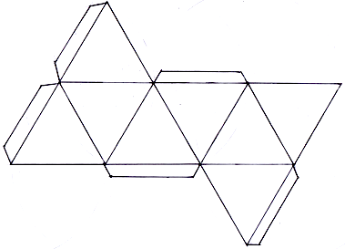
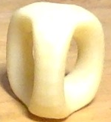
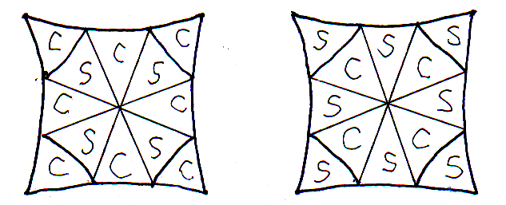
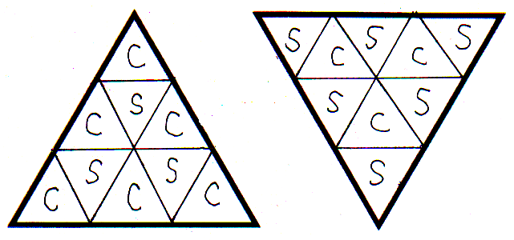
OTHER GEOMETRIES (CLIENT/SERVER)
SPHERE: Project a regular octahedron on it (shown unfolded to left) by central projection. The triangles to the left are client if base on bottom and server if base on top, as usual. This proves to be consistent when closed at tabs. For further subdivision, see technique at bottom.
M-FOLD TORUS (M>1): Express as M+1-legged stool with top and bottom seat (shown left for M=2). Cut vertically along axis into 2(M+1) half-legs, unfold each into a hyperbolic quadrilateral, alternating client-type and server-type, subdivided into triangles as at right.
Client-type
Server-type
FURTHER SUBDIVISION: For any n>1, subdivide each large triangle into n^2 small ones, client into client-type, server into server-type, as shown to right (n=3). Entire boundary is same type in each case, so coarse correctness carries over.
☑️

Slide 13
my xCORE-200 eXplorerKIT boards’ processor
xTIME scheduler
xTIME scheduler
2 tiles (500 MIPS per tile (or dual))
8 cores per tile (=«Logical cores»)
xTIME scheduler. If # cores active:
1-5 cores: 1/5 cycles each
6-8 cores: all cycles shared out
Deterministic thread execution
Channels: untyped. Synch or buffered
xC chanends (32 per tile)
xC interface (typed and role/session)
I/O ports
Clock blocks (6 per tile)
Timers (10 per tile)
xCORE logical core
tile[1] has 8 cores
tile[0] has 8 cores
Figure 1: XEF216-512-TQ128 block diagram, from XEF216-512-TQ128 Datasheet. 2018/03/23 Document Number: X006990 https://www.xmos.ai/download/XEF216-512-TQ128-Datasheet(1.15).pdf. As used in the xCORE-200 eXplorerKIT (external flash)
✅

Slide 14
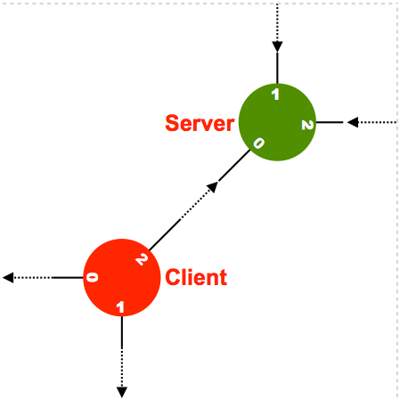
torus
4 nodes = 4 tasks
All equal as the occam initial example?
Roles (xC forces us to, as i * j increases)
Client
Server
«Eager» task not allowed
No sliding (=no data loss)
«Root» does timing and may «hold» all the others
Drawn like a parallelogram is more «torus-intuitive»
✅

Slide 15
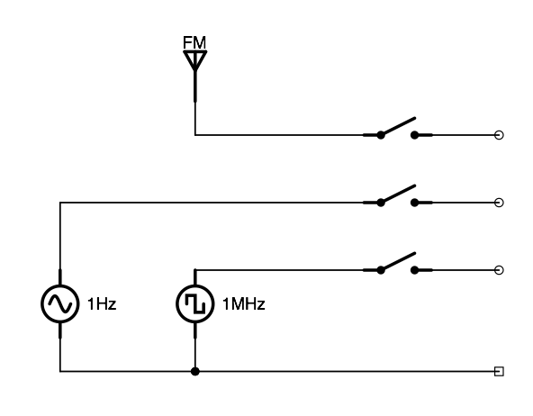
And we programmed in occam. Here, a one-pager
PAR
PROC
CHAN OF my_protocol
ALT
xC/go: select
INMOS Limited (UK). Assembly of the two texts done by Øyvind Teig from scans of the respective book covers, Public domain, via Wikimedia Commons
«ALT specifies a list of guarded commands. The guards are a combination of a boolean condition and an input expression (both optional)» (Wikipedia)
If allow_FM=FALSE sender will block until receiver is able to receive
Maybe FM instead is a streamed movie from a server which we may halt and restart and don’t loose any of the action? That server will nicely wait
WHILE TRUE
SEQ
ALT
(allow_FM=TRUE) & chan_1 ? data_from_FM
-- handle data_from_FM
(allow_1Hz=TRUE) & chan_2 ? data_from_1Hz
-- handle data_from_1Hz
(allow_1MHz=TRUE) & chan_3 ? data_from_1MHz
-- handle data_from_1MHz
Handle_common (..)
xC/go: select
allow_FM
allow_1Hz
allow_1MHz
Wanted («good») blocking as waiting since a task (of many - not as single threaded) would have nothing else to do during this waiting. This is CSP. See blog note 092
✅

Slide 16
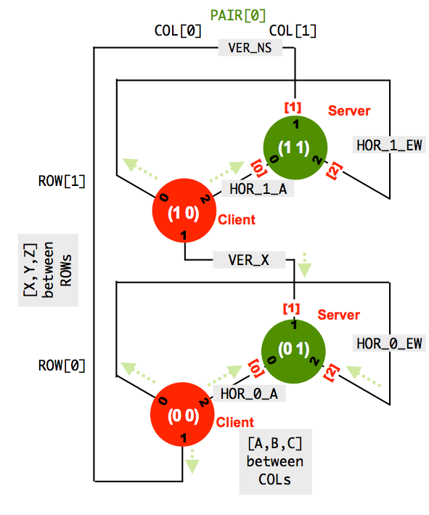
TEMPERATURE FLOW ON A TORUS. FOUR TASKS?
xC
int main (void) {
#define VER_NS_X [1][0][1] // NS North-South top-bottom
#define HOR_1_EW [1][0][2] // EW EastWest belt side-to-side
#define HOR_1_A [1][0][0] // [A,B,C] Between horisontal columns
#define VER_01_X [0][0][1] // [X,Y,Z] Between vertical rows
#define HOR_0_EW [0][0][2] // EW EastWest belt side-to-side
#define HOR_0_A [0][0][0] // [A,B,C] Between horisontal columns
chan chans [NUM_ROWS][NUM_PAIRS_PER_ROW][NUM_CONNS_PER_NODE];
// [ 2 ][ 1 ][ 3 ]
par {
on tile[0]:
par {
Client_node_root (0,0, chans HOR_0_EW, chans VER_NS_X, chans HOR_0_A,
outP4_leds);
Server_node (0,1, chans HOR_0_A, chans VER_01_X, chans HOR_0_EW);
}
on tile[1]:
par {
Client_node (1,0, chans HOR_1_EW, chans VER_01_X, chans HOR_1_A);
Server_node (1,1, chans HOR_1_A, chans VER_NS_X, chans HOR_1_EW);
}
}
return 0;
} // main
?
?
✅

Slide 17
xC: CLIENT AND SERVER ROLES SAVES US TASKS
void Client_node (
const unsigned iof_row,
const unsigned iof_col,
chanend chan_0,
chanend chan_1,
chanend chan_2) {
node_context_t context;
const params_t params = init_params ();
temp_degC_t temp_degC = init_temp (iof_row,iof_col, params);
init_wt (iof_row, iof_col, context.wt, params);
init_context (iof_row, iof_col, context);
while (1) { // Client_node_3_composite_par
par
{
{ // subtask 1
chan_0 <: temp_degC;
chan_0 :> context.temps_degC[0];
}
{ // subtask 2
chan_1 <: temp_degC;
chan_1 :> context.temps_degC[1];
}
{ // subtask 3
chan_2 <: temp_degC;
chan_2 :> context.temps_degC[2];
}
}
context.cycle_cnt++;
temp_degC = calculate_new_temp_from_flow (context, temp_degC);
}
}
void Server_node (
const unsigned iof_row,
const unsigned iof_col,
chanend chan_0,
chanend chan_1,
chanend chan_2) {
node_context_t context;
const params_t params = init_params ();
temp_degC_t temp_degC = init_temp (iof_row,iof_col, params);
init_wt (iof_row, iof_col, context.wt, params);
init_context (iof_row, iof_col, context);
while (1) {
par
{
{ // subtask 1
chan_0 :> context.temps_degC[0];
chan_0 <: temp_degC;
}
{ // subtask 2
chan_1 :> context.temps_degC[1];
chan_1 <: temp_degC;
}
{ // subtask 3
chan_2 :> context.temps_degC[2];
chan_2 <: temp_degC;
}
}
context.cycle_cnt++;
temp_degC = calculate_new_temp_from_flow (context, temp_degC);
}
}
Used bidirectionally
Clients send first, always take initiative
Servers respond to input only
✅

Slide 18
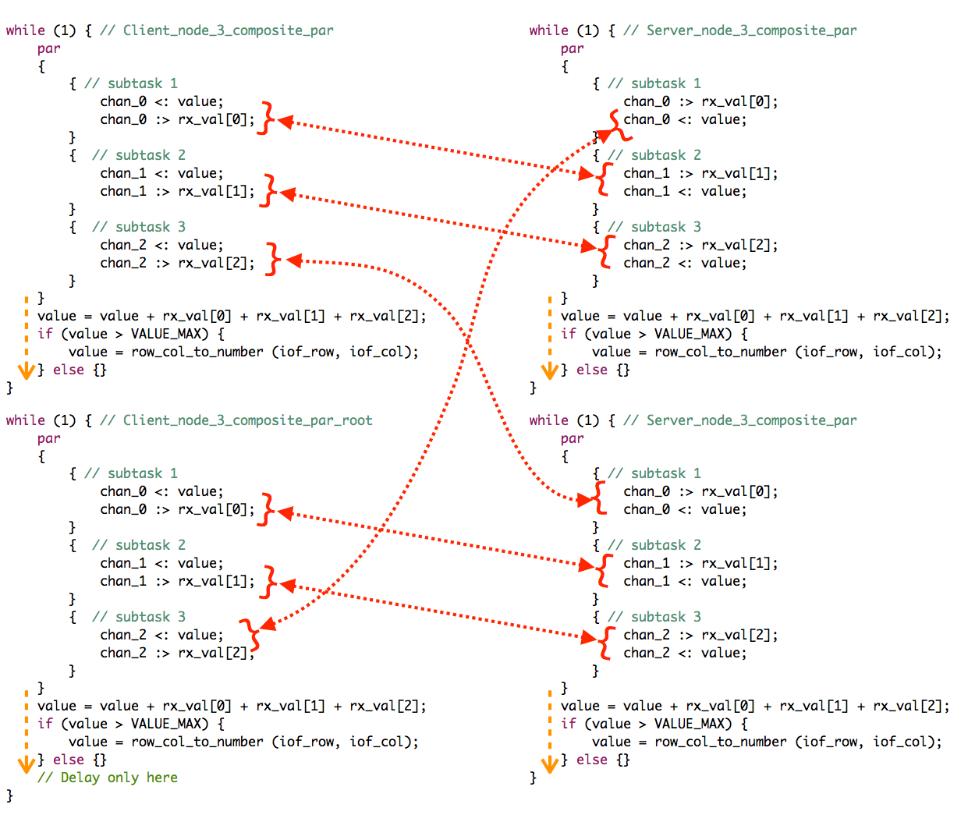
AS xC NORMAL task type (3) showing communication pattern
(Names don’t match previous page, they are according to blog 217)
4 tasks with 3 subtasks each =
12 tasks on
12 cores on
2 tiles
75% used!
Since all in synch!
✅

Slide 19
xC has task types
No restrictions
Combined selects
Called inline
From the XMOS Programming guide
✅

Slide 20
xC «normal» TASK type
Constraint check for tile[0]:
Cores available: 8, used: 6 . OKAY
Timers available: 10, used: 6 . OKAY
Chanends available: 32, used: 7 . OKAY
Memory available: 262144, used: 5220 . OKAY
(Stack: 1076, Code: 3328, Data: 816)
Constraints checks PASSED.
Constraint check for tile[1]:
Cores available: 8, used: 6 . OKAY
Timers available: 10, used: 6 . OKAY
Chanends available: 32, used: 7 . OKAY
Memory available: 262144, used: 4908 . OKAY
(Stack: 1076, Code: 3060, Data: 772)
Constraints checks PASSED.
Build Complete
Many tasks (max 16) and one per logical core is what (I think) the xCORE was originally built for
Having so much of what’s needed for concurrent programs in HW
But xC tasks were probably supposed to be rather unequal, rather large, and possibly with hard and deterministic timing requirements
Doing a mesh of a multitude of uniform, smaller tasks therefore challenges the xCORE/xC
✅

Slide 21
Comment
Finding the right way to make this large amount of tasks compilable and then runnable, has been the main challenge
However, we did «find» several ways to implement it
But runnability is like throwing with dice: scheduling issues and compiler issues (whichever comes first)…
But once a configuration has proven to run, it always runs
All done with XMOS xTIMEcomposer 14.4.1 and code running on an xCORE-200 eXplorer board
This lecture in no way pretends to be a textbook in xC. See XMOS Programming Guide (2015/9/21 version F, 2015/9/18 in the document), see https://www.xmos.ai/file/xmos-programming-guide
Alternatively, go to the References section of my note 141
✅

Slide 22
For fine text or {fine code;}
View presentation in full resolution at
https://www.teigfam.net/oyvind/home/technology/218-ieee-copa-2021-fringe/
plus: download of code and extras
✅

Slide 23
Normal task
Combinable task
Distributable task
#include <platform.h> // core
#include <timer.h> // delay_milliseconds(..), XS1_TIMER_HZ etc
// The simplest form of interface, no use of
// [[guarded]], [[notification]] slave, or [[clears_notification]]
// used for session type interfaces
//
typedef interface con_if_t {
unsigned set_get (const unsigned value);
} con_if_t;
// Instead if the common state my_value++ above,
// which is not allowed. For the same semantics,
// one call for each select case
//
unsigned calculate (const unsigned value) {
return (value+1);
}
// Called as inline function, on the caller's stack
// Third level of resitrictions apply
// When DISTRIBUTABLE only interfaces allowed as communication params
// No side effects with system, like timers, channels or ports
//
[[distributable]]
void my_distributable_task (server con_if_t i_con) {
unsigned my_value = 1; // Only interface
while (1) { // looping required
select {
case i_con.set_get (const unsigned value_in) ->
unsigned value_return : {
value_return = my_value;
my_value = value_in;
my_value = calculate (my_value);
} break;
}
}
}
// Like occam and go tasks. One per xCORE logical core.
// Expensive, so is most often a much more complex tast or one
// with very hard timing requirements
//
void my_normal_task (
server con_if_t i_con,
chanend c_chan_in, // Used unidirectionally here
in buffered port:32 p_pin) {
timer tmr; // one tick every 10 ns
signed time_ticks;
unsigned my_value = 1;
unsigned c_value_in;
unsigned pin_val;
p_pin :> pin_val; // read pin
tmr :> time_ticks;
time_ticks += XS1_TIMER_HZ;
while (1) { // looping not required
select {
case tmr when timerafter (time_ticks) :> void : {
my_value = -my_value;
} break;
case p_pin when pinsneq (pin_val) :> pin_val: {
// change on pin
my_value = 0;
} break;
case c_chan_in :> c_value_in : {
my_value = c_value_in;
} break;
case i_con.set_get (const unsigned value_in) ->
unsigned value_return : {
value_return = my_value;
my_value = value_in;
} break;
}
my_value++; // As function «calculate» for the others
// Shared state may be handled here
}
}
// Several of these may be combined in one select by the compiler
// First level of restrictions apply
//
[[combinable]]
void my_combinable_task (
client con_if_t i_con_0,
client con_if_t i_con_1,
chanend c_chan_out, // Used unidirectionally here
in port p_pin) {
timer tmr; // one tick every 10 ns
signed time_ticks;
unsigned my_value = 1;
unsigned pin_val;
p_pin :> pin_val; // read pin
tmr :> time_ticks;
time_ticks += XS1_TIMER_HZ;
while (1) { // looping required
select {
case tmr when timerafter (time_ticks) :> void : {
my_value = -my_value;
my_value = calculate (my_value);
my_value = i_con_0.set_get (my_value);
c_chan_out <: my_value;
} break;
case p_pin when pinsneq (pin_val) :> pin_val: {
// change on pin
my_value = 0;
my_value = calculate (my_value);
my_value = i_con_1.set_get (my_value);
} break;
// chanend ok, not used in example
// Server interface ok, not used in example
}
}
}
in buffered port:32 p_pin_b = on tile[0]: XS1_PORT_1M;
in port p_pin = on tile[0]: XS1_PORT_1N;
int main (void) {
con_if_t i_con_a;
con_if_t i_con_b;
chan c_chan;
par {
my_normal_task (i_con_a, c_chan, p_pin_b);
[[combine]]
par {
my_combinable_task (
i_con_a, i_con_b, c_chan, p_pin);
}
[[distribute]]
my_distributable_task (i_con_b);
}
return 0;
}
Normal tasks can also contain composite par
This example code shows task types,
the code examples are not related to the theme of this presentation
Constraint check for tile[0]:
Cores available: 8, used: 2 . OKAY
Timers available: 10, used: 2 . OKAY
Chanends available: 32, used: 4 . OKAY
Memory available: 262144, used: 2256 . OKAY
(Stack: 476, Code: 1570, Data: 210)
Constraints checks PASSED.
✅

Slide 24
Attempt at an anAlysis
Even if XMOS probably introduced these task types to make better use of
HW cores and and f.ex. HW chanends,
the user was given several types of task abstractions. Nice, but confusing at first
It then also probably is a selling point for the xCORE multicore processors
It’s not «only» 8 logical cores per tile, it’s a useful task abstraction that takes us in the direction of FPGA with VHDL or Verilog, but we instead have these independent hardware modules called «logical cores»
Plus, it does in fact let us do the toroid multi-node research
And control my aquarium’s temperature and LED light, etc. (here)
These xC task types are rather generic and could with advantage have been introduced to any real-time, scheduler or operating system
✅

Slide 25
Channels are obviously too expensive for our case
We are now leaving chan and chanend since they are too expensive. We can express 4*4 nodes, but not larger topologies
In order to cope with this limitation, xC has
The combinable and distributable tasks
Use of interfaces as protocol / session primitives, as already seen examles of
Often both channels and interface usage needed
Use of boolean expressions in the select()-guarded commands
✅

Slide 26
No sliding behaviour acceptED: repeatable converging value!
(0 1):S(0) [0.0000] "Server_node_task"
(1 1):S(0) [0.0000] "Server_node_task"
(1 0):C(0) [0.0000] "Client_node_task"
(0 0):C(0) [19.0000] "Client_node_task root" as "Top_26 2*2" on Mar 24 2021 18:14:51
(1 0):C(1) [0.00000000] from [0.0000][0.0000][0.0000]
(1 1):S(1) [0.47499999] from [0.0000][19.0000][0.0000]
(0 1):S(1) [2.37500000] from [19.0000][0.0000][19.0000]
(0 0):C(1) [18.54399872] from [0.0000][0.0000][0.0000] at 804 ms
(1 0):C(2) [0.09500000] from [0.4750][2.3750][0.4750]
(1 1):S(2) [0.86734998] from [0.0000][18.5440][0.0000]
(0 1):S(2) [4.33675003] from [18.5440][0.0000][18.5440]
(0 0):C(2) [18.14834213] from [2.3750][0.4750][2.3750] at 1905 ms
(1 0):C(3) [0.25707000] from [0.8673][4.3368][0.8673]
(1 1):S(3) [1.20283103] from [0.0950][18.1483][0.0950]
(0 1):S(3) [5.95715523] from [18.1483][0.0950][18.1483]
(0 0):C(3) [17.80298615] from [4.3368][0.8673][4.3368] at 3006 ms
. . .
(0 0):C(464) [12.50002575] from [12.5000][12.5000][12.5000] at 38029 ms
(1 0):C(465) [12.49995041] from [12.5000][12.5000][12.5000]
(1 1):S(465) [12.49995708] from [12.4999][12.5000][12.4999]
(0 1):S(465) [12.50000763] from [12.5000][12.4999][12.5000]
(0 0):C(465) [12.50002575] from [12.5000][12.5000][12.5000] at 39130 ms
(1 0):C(466) [12.49995136] from [12.5000][12.5000][12.5000]
(1 1):S(466) [12.49995804] from [12.5000][12.5000][12.5000]
(0 1):S(466) [12.50000858] from [12.5000][12.5000][12.5000]
All values must pass from cycle_cnt (0) to (1) to (n+1), no sliding
No sliding, but internal natural «strectching» may happen
19.000 on link 0 and 2 in cnt (0) for cnt (1)
19.000
(1 1)
(1 0)
(0 1)
19.000
19.000
19.000
(0 0)
19.000
Converging value 12.5000
Every time!
✅

Slide 27
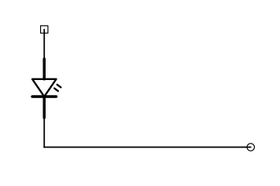
interface conn_if_t conn [NUM_ROWS][NUM_PAIRS_PER_ROW][NUM_CONNS_PER_NODE];
// [ 4 ][ 2 ][ 3 ]
#define VER_NS_Y [3][1][1] // NS North-South top-bottom
#define VER_NS_X [3][0][1] // NS North-South top-bottom
#define HOR_3_EW [3][1][2] // EW EastWest belt side-to-side
#define HOR_3_C [3][1][0] // [A,B,C] Between horisontal columns
#define HOR_3_B [3][0][2] // [A,B,C] Between horisontal columns
#define HOR_3_A [3][0][0] // [A,B,C] Between horisontal columns
#define VER_23_Y [2][1][1] // [X,Y,Z] Between vertical rows
#define VER_23_X [2][0][1] // [X,Y,Z] Between vertical rows
#define HOR_2_EW [2][1][2] // EW EastWest belt side-to-side
#define HOR_2_C [2][1][0] // [A,B,C] Between horisontal columns
#define HOR_2_B [2][0][2] // [A,B,C] Between horisontal columns
#define HOR_2_A [2][0][0] // [A,B,C] Between horisontal columns
#define VER_12_Y [1][1][1] // [X,Y,Z] Between vertical rows
#define VER_12_X [1][0][1] // [X,Y,Z] Between vertical rows
#define HOR_1_EW [1][1][2] // EW EastWest belt side-to-side
#define HOR_1_C [1][1][0] // [A,B,C] Between horisontal columns
#define HOR_1_B [1][0][2] // [A,B,C] Between horisontal columns
#define HOR_1_A [1][0][0] // [A,B,C] Between horisontal columns
#define VER_01_Y [0][1][1] // [X,Y,Z] Between vertical rows
#define VER_01_X [0][0][1] // [X,Y,Z] Between vertical rows
#define HOR_0_EW [0][1][2] // EW EastWest belt side-to-side
#define HOR_0_C [0][1][0] // [A,B,C] Between horisontal columns
#define HOR_0_B [0][0][2] // [A,B,C] Between horisontal columns
#define HOR_0_A [0][0][0] // [A,B,C] Between horisontal columns
par {
on tile[0]:
par {
}
on tile[0]:
par {
}
}
led_port
Client_node_task (0,0, conn HOR_0_EW, conn VER_NS_X, conn HOR_0_A, );
Server_node_task (0,1, conn HOR_0_A, conn VER_01_X, conn HOR_0_B);
par (unsigned ix = 0; ix < 14; ix++) is another construct
[[combine]]
Client_node_task (0,2, conn HOR_0_B, conn VER_NS_Y, conn HOR_0_C, null);
Server_node_task (0,3, conn HOR_0_C, conn VER_01_Y, conn HOR_0_EW);
Client_node_task (1,0, conn HOR_1_EW, conn VER_01_X, conn HOR_1_A, null);
Server_node_task (1,1, conn HOR_1_A, conn VER_12_X, conn HOR_1_B);
Client_node_task (1,2, conn HOR_1_B, conn VER_01_Y, conn HOR_1_C, null);
Server_node_task (1,3, conn HOR_1_C, conn VER_12_Y, conn HOR_1_EW);
Client_node_task (2,0, conn HOR_2_EW, conn VER_12_X, conn HOR_2_A, null);
Server_node_task (2,1, conn HOR_2_A, conn VER_23_X, conn HOR_2_B);
Client_node_task (2,2, conn HOR_2_B, conn VER_12_Y, conn HOR_2_C, null);
Server_node_task (2,3, conn HOR_2_C, conn VER_23_Y, conn HOR_2_EW);
Client_node_task (3,0, conn HOR_3_EW, conn VER_23_X, conn HOR_3_A, null);
Server_node_task (3,1, conn HOR_3_A, conn VER_NS_X, conn HOR_3_B);
Client_node_task (3,2, conn HOR_3_B, conn VER_23_Y, conn HOR_3_C, null);
Server_node_task (3,3, conn HOR_3_C, conn VER_NS_Y, conn HOR_3_EW);
led_port
✅

Slide 28
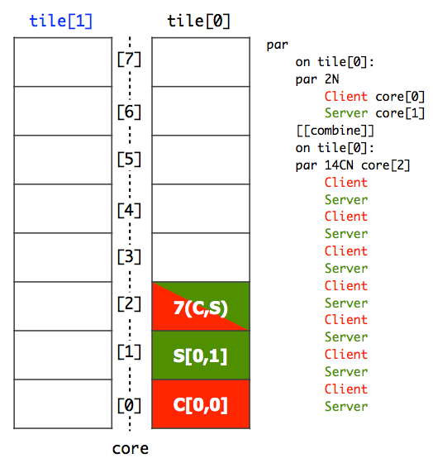
That’s better!
Fastest round trip, with all communications and calculations is 710 µs (where waiting in root must be 300 µs)
Done on each node after three comms:
typedef float temp_degC_t;
temp_degC_t calculate_new_temp_from_flow (
const node_context_t context,
const temp_degC_t tempold) {
const temp_degC_t term1 = context.wt[0] *
(context.temps_degC[0]-tempold);
const temp_degC_t term2 = context.wt[1] *
(context.temps_degC[1]-tempold);
const temp_degC_t term3 = context.wt[2] *
(context.temps_degC[2]-tempold);
return (tempold + term1 + term2 + term3;);
}
PS. float handling is through a library
If no use of combinable and placing on core 0-15 the fastest round trip is 28 µs with zero waiting in the root. Possible, since 16 nodes/tasks
✅

Slide 29
Expanding beyond 4*4 with Guarded interface protocol
FAILS
Server
// In Server_node. Pseudo code:
bool guard_0 = true; // close switch
bool guard_1 = true;
bool guard_2 = true;
while (1) {
select {
case guard_0 => i_conn_0. SET_GET_TEMP (
const temp_degC_t temp_degC) ->
temp_degC_t temp_degC_ret : {
guard_0 = false; // Done, open switch
// etc
} break;
// case 1 and 2
}
}
typedef interface g_conn_if_t {
[[guarded]] temp_degC_t SET_GET_TEMP (
const temp_degC_t temp_degC);
} g_con_if_t;
xcc1: internal compiler error
Failed in /jenkins/RELEASE_14_4/sb/tools_xcc1_c_llvm/FrontEnd/Lowering/
lower_combined_pars.cpp, line 183
info->stateObj
For bug reporting instructions, please see:
http://www.xmos.com/support
🔲

Slide 30
Expanding beyond 4*4 with ASYNCH interface protocol
FAILS
Client 0
Client 1
Server
Client 2
SET_TEMP
SET_TEMP
SET_TEMP
Work
Work
Work
Work
ALL_CLIENTS_SEEN
GET_TEMP
ALL_CLIENTS_SEEN
ALL_CLIENTS_SEEN
?
?
typedef float temp_degC_t;
typedef interface a_con_if_t {
void SET_TEMP (const temp_degC_t temp_degC_in);
[[notification]] slave void ALL_CLIENTS_SEEN (void);
[[clears_notification]] temp_degC_t GET_TEMP (void);
} a_con_if_t;
See blog 217
Builds, but does not seem to run correctly
I assume the scheme is made for a client at a time in server
🔲

Slide 31
Expanding beyond 4*4 with polling SYNCH phase
Succeeds
Client 0
Client 1
Server
Client 2
SET_GET_TEMP
ok (59)
SET_GET_TEMP
ok (59)
SET_GET_TEMP
ok (59)
Calculate (59)
All clients seen (59)
Red = cycle_cnt 59
SET_GET_TEMP
POLL_ALL_SYNCHED
POLL_ALL_SYNCHED
NO
NO
POLL_ALL_SYNCHED
YES
POLL_ALL_SYNCHED
YES
YES
SET_GET_TEMP
ok (60)
POLL_ALL_SYNCHED
Blue = cycle_cnt 60
NO
59 synching
POLL_ALL_SYNCHED
POLL_ALL_SYNCHED
YES
YES
All clients synched (59)
ok (60)
SET_GET_TEMP
typedef enum {false,true} bool;
typedef bool all_clients_synched_t;
typedef float temp_degC_t;
typedef interface conn_if_t {
temp_degC_t SET_GET_TEMP (const temp_degC_t temp_degC);
all_clients_synched_t POLL_ALL_SYNCHED (void);
} conn_if_t;
Also as [[combinable]]
SET_GET_TEMP
ok (60)
Servers as [[distributable]]
Builds and runs, but polling is often
a waste of cycles, not always as ok as here,
since the root is supposed to «wait» anyhow,
plus the latest finished node decides the speed
✅

Slide 32
The code is not as bad as the message sequence diagram (MSD)
Client
Server
while (1) { // In Client_node_task
select {
case tmr when timerafter (time_ticks) :> void : {
if (client_state == CS_SEND_DO_IO_SERVER) {
switch (iof_client) { // First this..
case 0: {
context.temps_degC[0] = i_conn_0.SET_GET_TEMP (temp_degC);
} break;
case 1: {
context.temps_degC[1] = i_conn_1.SET_GET_TEMP (temp_degC);
} break;
case 2: {
context.temps_degC[2] = i_conn_2.SET_GET_TEMP (temp_degC);
} break;
}
iof_client++; // ..then this
if (iof_client == NUM_CONNS_PER_NODE) {
iof_client = 0;
temp_degC = calculate_new_temp_from_flow (context, temp_degC);
context.cycle_cnt++; // at client NUM_CONNS_PER_NODE seen
client_state = CS_SYNCHRONIZE;
tmr :> time_ticks;
time_ticks += CLIENT_DELAY_UNTIL_NEXT_SYNCH_POLL_US * XS1_TIMER_MHZ;
} else { //doing next SET_GET_TEMP
tmr :> time_ticks;
time_ticks += CLIENT_DELAY_UNTIL_NEXT_THIRD_US * XS1_TIMER_MHZ;
}
while (1) { // In Server_node_task
select {
case i_conn_0.SET_GET_TEMP (const temp_degC_t temp_degC_in) -> temp_degC_t temp_degC_return : {
temp_degC_return = temp_degC; // always return old value
synch.client_tagged_key[0] = context.cycle_cnt; // not from synch.key
context.temps_degC[0] = temp_degC_in;
temp_degC = Handle_server_set_get (context, synch, temp_degC);
} break;
case i_conn_1.SET_GET_TEMP (const temp_degC_t temp_degC_in) -> temp_degC_t temp_degC_return : {
temp_degC_return = temp_degC; // always return old value
synch.client_tagged_key[1] = context.cycle_cnt; // not from synch.key
context.temps_degC[1] = temp_degC_in;
temp_degC = Handle_server_set_get (context, synch, temp_degC);
} break;
case i_conn_2.SET_GET_TEMP (const temp_degC_t temp_degC_in) -> temp_degC_t temp_degC_return : {
temp_degC_return = temp_degC; // always return old value
synch.client_tagged_key[2] = context.cycle_cnt; // not from synch.key
context.temps_degC[2] = temp_degC_in;
temp_degC = Handle_server_set_get (context, synch, temp_degC);
} break;
DATA
case i_conn_0.POLL_ALL_SYNCHED () ->
all_clients_synched_t all_clients_seen_return : {
all_clients_seen_return =
Handle_server_poll_all_clients_seen (0, context, synch);
} break;
case i_conn_1.POLL_ALL_SYNCHED () ->
all_clients_synched_t all_clients_seen_return : {
all_clients_seen_return =
Handle_server_poll_all_clients_seen (1, context, synch);
} break;
case i_conn_2.POLL_ALL_SYNCHED () ->
all_clients_synched_t all_clients_seen_return : {
all_clients_seen_return =
Handle_server_poll_all_clients_seen (2, context, synch);
} break;
}
}
} else if (client_state == CS_SYNCHRONIZE) {
if (not all_clients_seen[0]) {
all_clients_seen[0] = i_conn_0.POLL_ALL_SYNCHED ();
} else {}
if (not all_clients_seen[1]) {
all_clients_seen[1] = i_conn_1.POLL_ALL_SYNCHED ();
} else {}
if (not all_clients_seen[2]) {
all_clients_seen[2] = i_conn_2.POLL_ALL_SYNCHED ();
} else {}
if (all_clients_seen[0] and all_clients_seen[1] and all_clients_seen[2]) {
for (unsigned ix=0; ix<NUM_CONNS_PER_NODE; ix++) {
all_clients_seen[ix] = false;
}
iof_client = 0;
client_state = CS_SEND_DO_IO_SERVER;
tmr :> time_ticks;
time_ticks += (ROOT_WAIT_FOR_NEXT_ROUND_US * (unsigned) root);
} else {
tmr :> time_ticks;
time_ticks += (CLIENT_DELAY_UNTIL_NEXT_SYNCH_POLL_US * XS1_TIMER_MHZ);
}
}
} break;
}
}
Synchronize
Client with its three servers
Server with its three clients
No operating system!
Just xC and the HW on the xCORE
✅

Slide 33
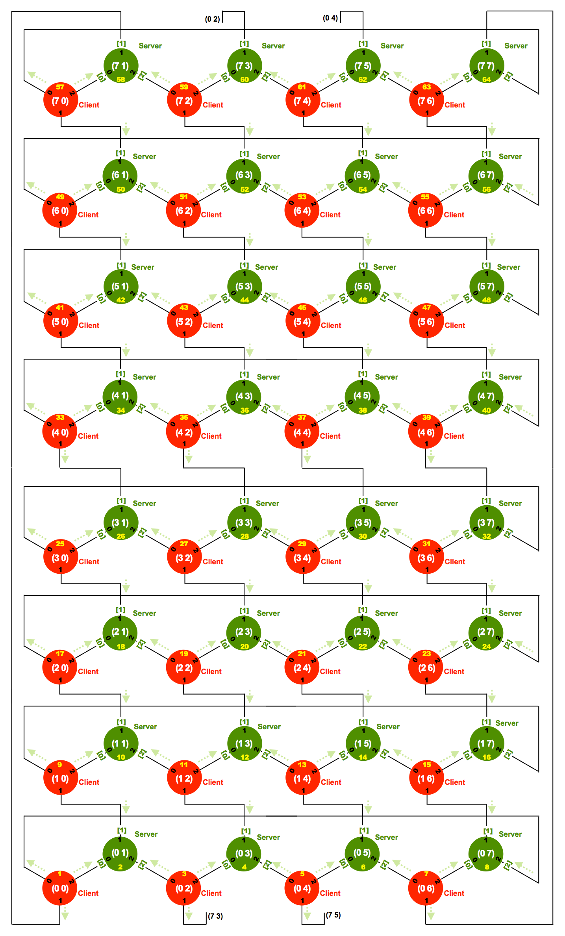
8*8 nodes As distributable (with the same code as just shown)
NUM 1-64
(2 2):C(1002) [50.00000000] from [18.0000][12.0000][20.0000]
(5 7):S(1002) [90316.00000000] from [407.0000][89524.0000][385.0000]
(4 2):C(1003) [91124.00000000] from [891.0000][406.0000][89827.0000]
(6 6):C(1002) [87689.00000000] from [54.0000][87579.0000][56.0000]
(4 4):C(1003) [37.00000000] from [89827.0000][432.0000][89865.0000]
(4 6):C(1003) [91232.00000000] from [89865.0000][434.0000][933.0000]
(0 7):S(1000) [88248.00000000] from [88232.0000][15.0000][1.0000]
(7 1):S(1000) [88522.00000000] from [88462.0000][1.0000][59.0000]
(0 1):S(1000) [13.00000000] from [1.0000][9.0000][3.0000]
(0 7):S(999) [88882.00000000] from [7.0000][88874.0000][1.0000]
(7 1):S(999) [6155.00000000] from [3090.0000][1.0000][3064.0000]
(0 1):S(999) [83444.00000000] from [1.0000][83440.0000][3.0000]
(0 0):C(1000) [1.00000000] from [88882.0000][6155.0000][83444.0000] at 37849 ms
Tasks may be 3 «ahead» or 3 «behind»:
In the window between the first cycle_cnt (1000) and last (1000) (which is the root)
we see nodes lagging behind in their calculations (997), (998) and (999)
but also some being ahead (1001), (1002) and (1003)
This reflects the 8*8 node’s internal natural «stretch» of +/- 3
However, no sliding of data!
Values always pass from cycle_cnt (n) to (n+1) = no sliding
int main (void) {
interface conn_if_t conn [NUM_ROWS][NUM_PAIRS_PER_ROW][NUM_CONNS_PER_NODE];
// [ 8 ][ 4 ][ 3 ]
#define VER_R_A(row) [row][3][1] // [X,Y,Z,A] Between vertical rows
#define VER_R_Z(row) [row][2][1] // [X,Y,Z,A] Between vertical rows
#define VER_R_Y(row) [row][1][1] // [X,Y,Z,A] Between vertical rows
#define VER_R_X(row) [row][0][1] // [X,Y,Z,A] Between vertical rows
#define HOR_R_EW(row) [row][3][2] // EW EastWest belt side-to-side
#define HOR_R_G(row) [row][3][0] // [A,B,C] Between horisontal columns
#define HOR_R_F(row) [row][2][2] // [A,B,C] Between horisontal columns
#define HOR_R_E(row) [row][2][0] // [A,B,C] Between horisontal columns
#define HOR_R_D(row) [row][1][2] // [A,B,C] Between horisontal columns
#define HOR_R_C(row) [row][1][0] // [A,B,C] Between horisontal columns
#define HOR_R_B(row) [row][0][2] // [A,B,C] Between horisontal columns
#define HOR_R_A(row) [row][0][0] // [A,B,C] Between horisontal columns
par {
on tile[0]:
par {
Client_node_task (0,0, conn HOR_R_EW(0), conn VER_R_X(7), conn HOR_R_A(0), outP4_leds);
Client_node_task (0,2, conn HOR_R_B(0), conn VER_R_Y(7), conn HOR_R_C(0), null);
}
on tile[0]:
[[combine]]
par {
Client_node_task (0,4, conn HOR_R_D(0), conn VER_R_Z(7), conn HOR_R_E(0), null);
Client_node_task (0,6, conn HOR_R_F(0), conn VER_R_A(7), conn HOR_R_G(0), null);
Client_node_task (1,0, conn HOR_R_EW(1), conn VER_R_X(0), conn HOR_R_A(1), null);
Client_node_task (1,2, conn HOR_R_B(1), conn VER_R_Y(0), conn HOR_R_C(1), null);
Client_node_task (1,4, conn HOR_R_D(1), conn VER_R_Z(0), conn HOR_R_E(1), null);
// 24 clients removed here
Client_node_task (7,6, conn HOR_R_F(7), conn VER_R_A(6), conn HOR_R_G(7), null);
}
on tile[0]: [[distribute]] Server_node_task (0,1, conn HOR_R_A(0), conn VER_R_X(0), conn HOR_R_B(0));
on tile[0]: [[distribute]] Server_node_task (0,3, conn HOR_R_C(0), conn VER_R_Y(0), conn HOR_R_D(0));
on tile[0]: [[distribute]] Server_node_task (0,5, conn HOR_R_E(0), conn VER_R_Z(0), conn HOR_R_F(0));
on tile[0]: [[distribute]] Server_node_task (0,7, conn HOR_R_G(0), conn VER_R_A(0), conn HOR_R_EW(0));
// 26 servers removed here on tile[0]: [[distribute]] Server_node_task (7,5, conn HOR_R_E(7), conn VER_R_Z(7), conn HOR_R_F(7));
on tile[0]: [[distribute]] Server_node_task (7,7, conn HOR_R_G(7), conn VER_R_A(7), conn HOR_R_EW(7));
}
X Y Z A
ROW 0-7
A B C D E F G EW
COL 0-7
Constraint check for tile[0]:
Cores available: 8, used: 3 . OKAY
Timers available: 10, used: 3 . OKAY
Chanends available: 32, used: 1 . OKAY
Memory available: 262144, used: 94120 . OKAY
(Stack: 49796, Code: 40084, Data: 4240)
Constraints checks PASSED.
✅

Slide 34
Expanding beyond 8*8 with
a master «NEXT PHASE» TICKS?
Since the simplest protocol g_con_if_t does not compile on the present xTIMEcomposer
and thus may be (part of) the reason why xC par seems/is "less scalable" than the occam PAR ..
..communication "in par" in composed task with interface and [[combine]] par is not tried
Maybe we could still do without the polling synch phase
and have each client just "wait" for a «next» tick from a master timing node (ie. the root)?
Is this a feasible way to simulate a barrier?
What would the pros and cons be?
I would have started with these interfaces…
// SIMPLER BETWEEN ALL (no polling synch phase)
typedef interface conn_if_t {
temp_degC_t SET_GET_TEMP (const temp_degC_t temp_degC);
} conn_if_t;
// FROM CLIENTS TO ROOT or SYNCH task:
typedef interface wait_if_t {
void WAIT (const unsigned cycle_cnt); // cnt needed?
} wait_if_t;
// BACK TO CLIENTS AFTER SAME cycle_cnt FROM ALL:
typedef interface next_if_t {
void NEXT (void);
} next_if_t;
…the blog note contains a test of this, including some result
✅

Slide 35
Summary
We did a lot of hooping, and the hoop often fell to the ground
Compiler internal error. Crash in some «line 183» of an LLVM code piece. Waiting for a new xTIMEcomposer version (using 14.4.1)
Code that compiles but will not run (if all tasks are combined then the code may run to a point when progress fails.) I have not discovered how to stop this on the code. But if it stops, it stops fast. See blog note 217
Lots of solutions that we failed on (two shown here). Sadly, the simplest.. failed («guarded»)
But xC is so multifaceted that we had some degree of success
Topology as 8 by 8 = 64 nodes was possible
«Lucky» that the servers could be distributable!
Observe that xTIMEcomposer should be able to simulate all of this code (with the same timing and deterministic properties as the real HW), without any xCORE-200 eXplorer board. xTIMEcomposer is free to download
Future work: other topologies, other sizes
This was my last page, so thanks for listening!
(As mentioned: code and presentation available at https://www.teigfam.net/oyvind/home/technology/218-ieee-copa-2021-fringe/)
✅

Slide 36
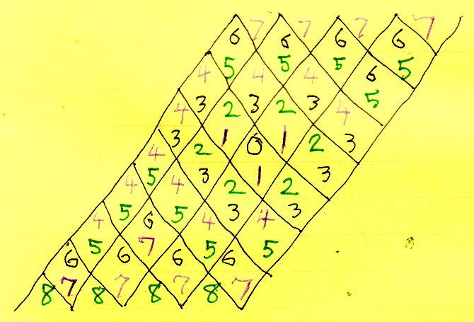
AVOIDING BARRIERS BUT STAYING VALID
Every communication must be between two nodes in the same cycle. (Proof by induction.) This is important - violates the conservation law otherwise - but surprisingly hard to enforce. Barriers would do it, but we deliberately want to avoid barriers, letting the nodes get a little, but not much, out of sync at the same time. The table on the left shows how many cycles it takes for synchrony to transmit.
What is the advantage of the avoidance of barriers?
In massively parallel operations (like climate modeling), individual nodes sometimes become much slower than average. If barriers are used, this immediately slows down the entire program, perhaps thousands of nodes. In many cases, if the slowdowns are sporadic and happen at different nodes at different times, the occam-style loose linkage between different distant nodes will cause this effect to be vastly mitigated.
☑️

Slide 37
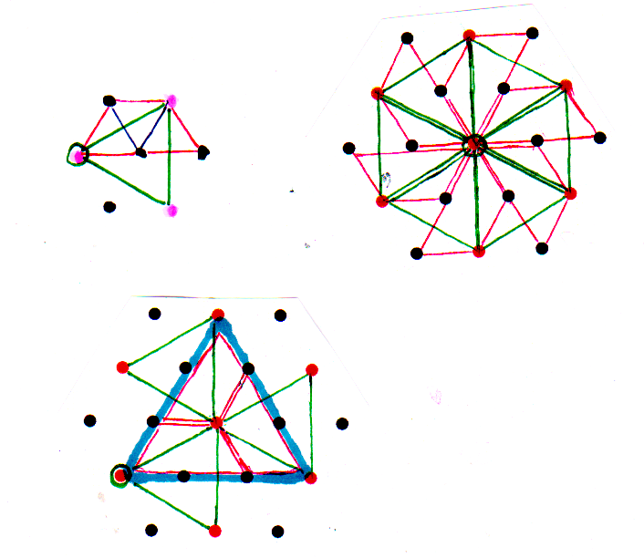
FUTURE WORK
(A) This approach is meant to emulate massively parallel hardware, of the GPU or AI type, that will be used on physically challenging problems like climate modeling.
We wish to extend it to:
Nonlinear equations
Non-euclidean geometries
Relaxation methods
(B) We need to design data flow in and out while modeling is underway, while preserving massive parallelism. One of us (Larry) devised the “shuriken blade” approach to move data on a 9 - 3 - 1 tree (thus with a fanout of 4) while preserving its locality. We need to:
Actually implement this
Use it for radiation and IO emulation
Important note: climate on a sphere does not need non-local radiation feedback. Torus is worse in this case (inner part radiates to distant nodes)
(C) We need to reach to vastly greater node count (e.g. from 64 to 576, from 16 to 144 or 1296, and beyond that to emulate 100,000 or more nodes, which we foresee in hardware). It does not matter if the emulation is slow.
Improve number of soft nodes per hard node on the xC
Connect multiple xC while retaining CSP purity, like Transputer links
☑️

Slide 38
FUTURE POSSIBILITIES
The items here are from a less urgent wish list: perhaps we can get along without them.
One of us (Larry) would particularly like an occam 2 compiler, or an occam 2 translator to xC, so as to be able to simplify the steps to emulations that are not naturally client-server
If local workspace for soft processes can be managed, it should be easy to simulate the Transputer model, which is of trivial complexity by modern standards
Process queue delays can be kept predictable by the nature of emulations
It would really be good if the occam compiler/translator could take advantage of the hardware advances of the xCore, such as its subdivision of tiles by staggered cycles
As mentioned above, external links on the CSP model would open the door to really big emulations and other uses that stay strict in their adherence to CSP
We could branch out to hardware design and mapping to GPU/AI chips, and so apply the results of the emulations to real hardware
☑️

