Slide 1
Unravelling concepts
XC
XC
[[combine]],
[[combinable]],
[[distribute]],
[[distributable]] anD
[[distributed(..)] PLUS
par
and
on
..
Øyvind TEIG²
Coder and blogger
CPA 2018 IN DRESDEN, GERMANY. AUGUST 19-22, 2018
COMMUNICATING PROCESS ARCHITECTURES¹
A fringe lecture
¹ http://wotug.cs.unlv.edu
my 23rd WoTUG/CPA
² http://www.teigfam.net/oyvind/home/ = Aclassifier with 40 years of embedded and safety-critical
coding (including some years of occam). Home lab («retired») since June 2017
20Aug2018

Slide 2
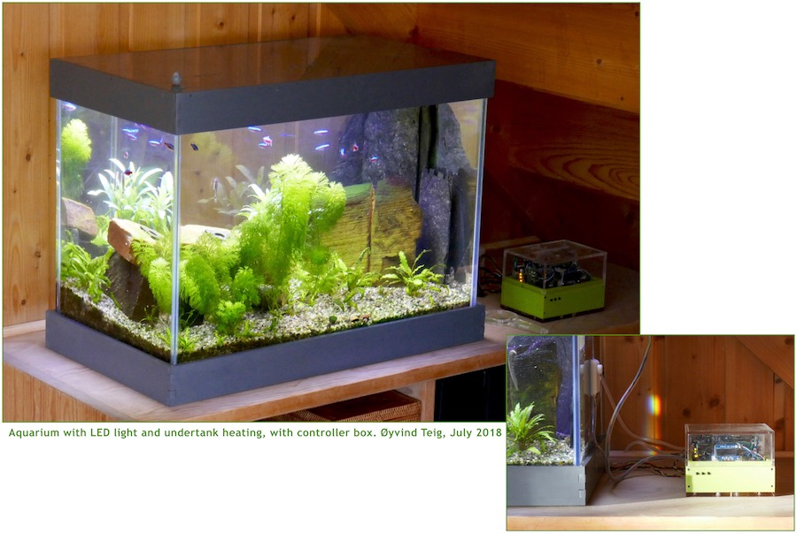
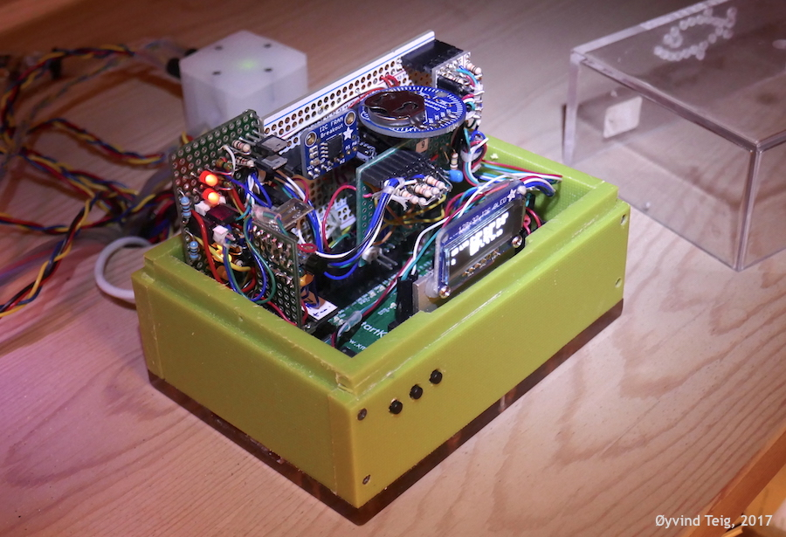
Disclaimer:
I have no other association with xmos than I used to have with INMOS: null ,
except the occasional contact through mail or the xcore forum,
ie No money, no gifts, no ads, no nothing..
..Only fun and expenses
But I do use xmos boards in my rather extended aquarium project
and as a background for my xmos related blogging (same disclaimer).
like in the note « XC is C plus X»³
³ http://www.teigfam.net/oyvind/home/technology/141-xc-is-c-plus-x/

Slide 3
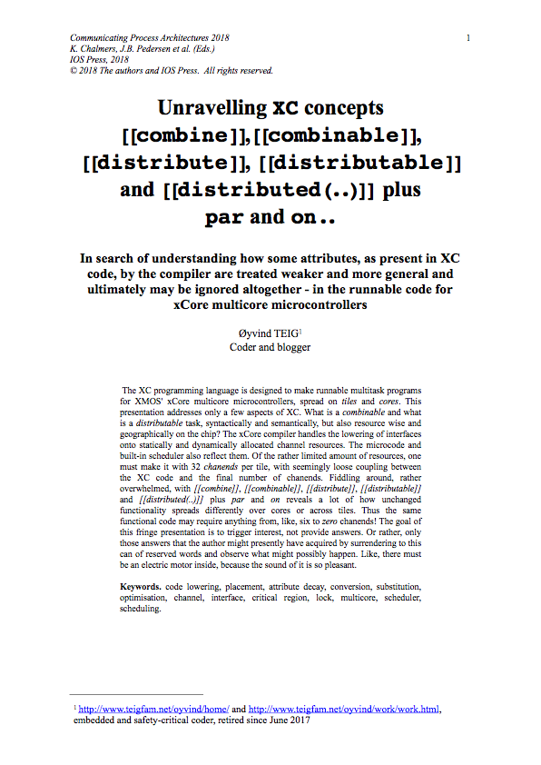
PLUS ‘X’?
C
!
‘X’ the unknown, no question-mark. but fun

Slide 4
XC
01
02
03
04
05
06
07
08
09
10
11
12
13
14
15
16
17
18
19
20
21
22
23
24
25
26
27
28
29
30
31
32
33
34
35
36
37
39
40
41
42
interface button_if_t {
void but (int x);
};
1
Constraint check for tile[0]:
Cores available: 8, used: 4 . OKAY
Timers available: 10, used: 4 . OKAY
Chanends available: 32, used: 6 . OKAY
Memory available: 65536, used: 1464 . OKAY
(Stack: 372, Code: 882, Data: 210)
typedef enum {false,true} bool;
[[combinable]]
2
[[distributable]] // [[combinable]]
void handle (server interface button_if_t i_but[3]) {
int cnt = 0; timer tmr;
int time;
bool timeout = false;
tmr :> time;
while (1) {
select {
case i_but[int i].but (int ms) : {
// Do something
timeout = false;
break;
}
case tmr when timerafter(time) :> void: {
timeout = true;
time += XS1_TIMER_HZ; // One second
break;
}
}
cnt++;
}
}
// int cnt = 0;
// timer tmr;
// int time;
// bool timeout = false;
// tmr :> time;
3
Constraint check for tile[0]:
Cores available: 8, used: 1 . OKAY
Timers available: 10, used: 1 . OKAY
Chanends available: 32, used: 0 . OKAY
Memory available: 65536, used: 1852 . OKAY
(Stack: 404, Code: 1228, Data: 220)
Constraints checks PASSED.
// timeout = false;
// case tmr when timerafter(time) :> void: {
// timeout = true;
// time += XS1_TIMER_HZ; // One second
// break;
// }
4
Constraint check for tile[0]:
Cores available: 8, used: 1 . OKAY
Timers available: 10, used: 1 . OKAY
Chanends available: 32, used: 0 . OKAY
Memory available: 65536, used: 1756 . OKAY
(Stack: 404, Code: 1132, Data: 220)
Constraints checks PASSED.
// cnt++;
5
Constraint check for tile[0]:
Cores available: 8, used: 2 . OKAY
Timers available: 10, used: 2 . OKAY
Chanends available: 32, used: 4 . OKAY
Memory available: 65536, used: 1728 . OKAY
(Stack: 376, Code: 1090, Data: 262)
Constraints checks PASSED.
int main (void) {
interface button_if_t i_but[3];
par {
par {
handle (i_but);
button (i_but[0]);
button (i_but[1]);
button (i_but[2]);
}
}
return 0;
}
[[combine]]
[[combine]]
par (int j = 0; j < 3; j++) {
button (i_but[j]);
}
[[combine]]
par {
handle (i_but);
}
[[distribute]] // [[combine]]
6 Wrong error message
../src/main.xc:366:1: error: distributed statement must be a call to a distributable function

Slide 5
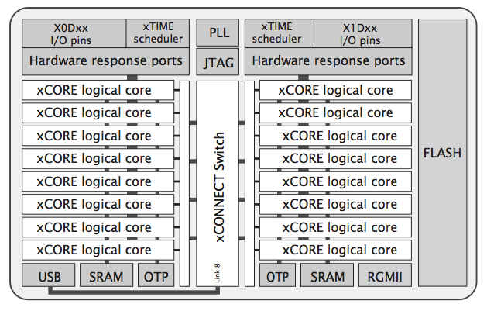
my xCORE-200 eXplorerKIT boards’ processor
2 tiles (500 MIPS per tile (or dual))
8 cores per tile (=«Logical cores»)
xTIME scheduler. If # cores active:
1-4 cores: 1/4 cycles each
5-8 cores: all cycles shared out
Deterministic thread execution
Thread safe
pragma for some deadlines
Channels: untyped. Synch or asynch
XC chanends (32 per tile)
Not between tasks on the same core
XC interface (typed and role/session)
May use chanends or locks or sharing of select or context (blocks of state data)
Shared memory & no data bus contention
No cache
No DMA
I/O does not use memory bus
Also supported/used by XC
Locks (4 per tile). Runtime
I/O ports
Clock blocks (6 per tile)
Timers (10 pr tile)
Figure 1: XEF216-512-TQ128 block diagram, from XEF216-512-TQ128 Datasheet. 2018/03/23 Document Number: X006990 http://www.xmos.com/download/private/XEF216-512-TQ128-Datasheet%281.15%29.pdf. As used in the xCORE-200 eXplorerKIT.

Slide 6
XC
01
02
03
04
05
06
07
08
09
10
11
12
13
14
15
16
17
18
19
20
21
22
23
24
25
26
27
28
29
30
31
32
33
34
35
#include <platform.h>
#include <stdio.h>
#include <timer.h> // XS1_TIMER_HZ etc
interface button_if_t {
void but (int x);
};
void button (client interface button_if_t i_but) {
timer tmr;
int time;
tmr :> time;
while (1) {
select {
case tmr when timerafter(time) :> void: {
i_but.but(time/XS1_TIMER_KHZ); // send button and ms
time += XS1_TIMER_HZ;
break;
}
}
}
}
void handle (server interface button_if_t i_but[3]) {
while (1) {
select {
case i_but[int i].but (int ms) : {
// Do something
break;
}
}
}
}
7
36
37
38
39
40
41
42
43
44
45
46
47
A
A
A
A
A
A
A
A
A
A
A
A
int main (void) {
interface button_if_t i_but[3];
par {
}
return 0;
}
[[combinable]]
[[combinable]]
on tile[0].core[0]: handle (i_but); // 6 chanends
par {
on tile[0].core[2]: button (i_but[0]);
on tile[0].core[3]: button (i_but[1]);
on tile[0].core[4]: button (i_but[2]);
}
36
37
38
39
40
41
42
43
44
45
46
47
48
B
B
B
B
B
B
B
B
B
B
B
B
B
int main (void) {
interface button_if_t i_but[3];
par {
}
return 0;
}
8
handle (i_but);
par {
button (i_but[0]);
button (i_but[1]);
button (i_but[2]);
}
[[combine]] // 4 chanends
36
37
38
39
40
41
42
43
44
45
46
47
48
C
C
C
C
C
C
C
C
C
C
C
C
C
int main (void) {
interface button_if_t i_but[3];
par {
}
return 0;
}
3
[[combine]] // 0 chanends
par {
handle (i_but);
button (i_but[0]);
button (i_but[1]);
button (i_but[2]);
}

Slide 7
XC real life @ Aquarium controller
On XMOS startKIT (I have several, after eol reached)
int main() {
... chan and interfaces
par {
on tile[0]: installExceptionHandler();
par {
startkit_adc (c_analogue); // Is none since a "service"/hardware
on tile[0]: My_startKIT_ADC_Task (i_startkit_adc_acquire, i_lib_startkit_adc_commands, // Is none since contains a nested select
NUM_STARTKIT_ADC_NEEDED_DATA_SETS);
on tile[0]: System_Task (i_i2c_internal_commands[0], i_i2c_external_commands[0], // Is none since contains a nested select
i_lib_startkit_adc_commands[0], i_port_heat_light_commands[0],
i_temperature_heater_commands[0], i_temperature_water_commands,
/* tile[0].core[0] not now */ i_buttons, i_irq, i_radio);
on tile[0]: adc_task (i_startkit_adc_acquire, c_analogue, // [[combinable]]
ADC_PERIOD_TIME_USEC_ZERO_IS_ONY_QUERY_BASED);
}
on tile[0]: {
[[combine]]
par {
Button_Task (IOF_BUTTON_LEFT, inP_button_left, i_buttons[IOF_BUTTON_LEFT]); // [[combinable]]
Button_Task (IOF_BUTTON_CENTER, inP_button_center, i_buttons[IOF_BUTTON_CENTER]); // [[combinable]]
Button_Task (IOF_BUTTON_RIGHT, inP_button_right, i_buttons[IOF_BUTTON_RIGHT]); // [[combinable]]
}
}
on tile[0]: {
[[combine]]
par {
I2C_Internal_Task (i_i2c_internal_commands); // [[combinable]]
I2C_External_Task (i_i2c_external_commands); // [[distributable]]
Temperature_Heater_Task (i_temperature_heater_commands, // [[combinable]]
i_i2c_external_commands[1],
i_port_heat_light_commands[1]);
Temperature_Water_Task (i_temperature_water_commands, // [[combinable]]
i_temperature_heater_commands[1]);
Port_Pins_Heat_Light_Task (i_port_heat_light_commands); // [[combinable]]
}
}
on tile[0]: { // To avoid Error: lower bound could not be calculated (xTIMEcomposer 14.3.3)
[[combine]]
par {
RFM69_driver (i_radio, p_spi_aux, i_spi[SPI_CLIENT_0], SPI_CLIENT_0); // [[distributable]]
spi_master_2 (i_spi, NUM_SPI_CLIENT_USERS, p_sclk, p_mosi, p_miso, // [[distributable]]
SPI_CLOCK, p_spi_cs_en, maskof_spi_and_probe_pins, NUM_SPI_CS_SETS);
IRQ_detect_task (i_irq, p_spi_irq, probe_config, null, 0); // [[combinable]]
}
}
}
return 0;
}
int main() {
... chan and interfaces
chan c_analogue; // chans always untyped
// interfaces:
button_if i_buttons[BUTTONS_NUM_CLIENTS];
spi_master_if i_spi [NUM_SPI_CLIENT_USERS];
radio_if_t i_radio;
irq_if_t i_irq;
i2c_external_commands_if i_i2c_external_commands [I2C_EXTERNAL_NUM_CLIENTS];
i2c_internal_commands_if i_i2c_internal_commands [I2C_INTERNAL_NUM_CLIENTS];
startkit_adc_acquire_if i_startkit_adc_acquire;
lib_startkit_adc_commands_if i_lib_startkit_adc_commands [ADC_STARTKIT_NUM_CLIENTS];
port_heat_light_commands_if i_port_heat_light_commands [PORT_HEAT_LIGHT_SERVER_NUM_CLIENTS];
temperature_heater_commands_if i_temperature_heater_commands[HEATER_CONTROLLER_NUM_CLIENTS];
temperature_water_commands_if i_temperature_water_commands;
par {
... Placement of tasks
}
return 0;
}
... chan and interfaces
// interfaces:
button_if i_buttons[3];
spi_master_if i_spi [1];
radio_if_t i_radio;
irq_if_t i_irq;
i2c_external_commands_if i_i2c_external_commands [2];
i2c_internal_commands_if i_i2c_internal_commands [1];
startkit_adc_acquire_if i_startkit_adc_acquire;
lib_startkit_adc_commands_if i_lib_startkit_adc_commands [1];
port_heat_light_commands_if i_port_heat_light_commands [2];
temperature_heater_commands_if i_temperature_heater_commands[2];
temperature_water_commands_if i_temperature_water_commands;
EXPERIMENT AND LEARN
mostly about XC but also
slalom with the compiler/mapper/linker
Constraint check for tile[0]:
Cores available: 8, used: 7 . OKAY
Timers available: 10, used: 8 . OKAY
Chanends available: 32, used: 26 . OKAY
Memory available: 65536, used: 61620 . OKAY
(Stack: 6472, Code: 49386, Data: 5762)
Constraints checks PASSED.
14Aug2018

Slide 8
Common term for [[combine]],[[combinable]], [[distribute]], [[distributable]] and [[distributed(..)]] does not seem to exist
Not all shown here. More on «XC is C plus X»
chan and interface code compared side by side (next page, small text, just for reference) (It also shows where the tool fails for some usages)
The XC reference I use the most¹
Plus the XCORE Exchange community forum²
¹ XMOS Programming Guide
as of 14Aug2018: 2015/9/21 version F, 2015/9/18 in the document,
https://www.xmos.com/published/xmos-programming-guide
² https://www.xcore.com

Slide 9
chan
interface
More down here in blog note

Slide 10
Inside the tool chain (from an insider)
The xCore compiler handles the «lowering of interfaces» onto statically and dynamically allocated channel resources
Program Content Analysis (optional but on by default) into a pca-file (xml)
Compilation into Abstract Syntax Tree
Specialisation stage using pca-file
The XC compiler will generate multiple versions of «interface lowered» code
for when the server and client are on different tiles or cores
for when the server and client are actually combined
for when the server and client are actually distributed
for when a server may need to be re-entrant (yielding), due to a possible calling cycle
The linker runs, linking together the object code, and throwing away unused (non specialised) functions
In an .s-file there would be duplicate content but with different boiler plating regarding how chanends and blocks of state data (holding chanends) are used

Slide 11
Summary
These terms are much «trial and see» (how the sw or tool works). Maybe this has to be so?
The tool goes to extremes, with free will - guided by me, to build thread safe and smart code to utilise the cores and not make any task interfere with any other task
Here → is my aquarium LED light PWM task that watches over light intensity. It flickered only before the algorithm was finished
Shared with full code and tasks for heat control, clock/calendar, day/night, soft light control, «cloud on the sky», display, buttons, I2C + SPI libraries and a radio client (main shown here)
There probably is no electric motor inside the xCore machines. But to me it sounds like one!
Austrått manor

Slide 12
Austrått manor
Thank you!
This and more at http://www.teigfam.net/oyvind/home/technology/175-cpa-2018-fringe/
2 extra summary pages?

Slide 13
From the XMOS Programming guide ¹

Slide 14
Collected mostly on xcore exchange and from here
Channels cannot be used between combined tasks
A distributable task can be implemented very efficiently if all the tasks it connects to are on the same tile
Distributed doesn't require its own cycles. Basically calling a function where the calling thread uses its cycles to run the code
Either of these cause the compiler to emit different versions of the same task which may be
Combined: Suitable for select combining, forked and run as an stand alone task
Distributed: select flattening, inlined as a function
In each case the functionality/logic is the same, however the implementation (and timing) may be significantly different
If they are 'distributed' or 'combined' then the code runs in quite different ways viz
Combined: on a another core co-operatively multitasking with other tasks
Distributed: on the caller's stack/core
Implicit 'decay' to weaker attributes viz: distributed->combined->single-core
Indeed the compiler emits all the code necessary for the linker to chose the eventual usage - throwing the rest away!
Thank you!

